Slide 1



TOSKY BUILDING SYSTEMS BASED ON THE CLOUD
B2BFrom B2Ccomplete system development/Maintenance, Data Lake Construction,
providing knowledge services combined with artificial intelligence
We are TOSKY.
Learn More
Contact Us
Website: tosky.co.kr Tel: 02-453-4628 Email: groove2u@tosky.co.kr
COPYRIGHT 2014 BY TOSKY, ALL RIGHTES RESERVED.
2014
TOSKY's Beginning
100+
Services Together

Slide 2

TOSKY Introduction
SUMMARY
AWS and other public Cloud-based System Development/MaintenanceFrom Public Projects and AI-based Knowledge Servicesto, We are ITBased on diverse customer needs, we confidently deliver tailored services For our clients' business success, we provide a wide range of experiences.
Company Name | ㈜TOSKY
Headquarters | Seongdong-gu, Seoul Yeonmujang5gil 9-16 Bluestone Tower 1103~5ho
Phone | 02-453-4628
Employees | 39 persons
Established | 2014. 08
Business Areas
System Architecture
Project Management
Solution Development
Web/Mobile Application
IT Consulting
Web Development

Slide 3


TOSKY Business Fields
BUSINESS PLAN
01
Public Cloud -based System Construction and Maintenance
Key Services
Cloud Architecture Design
Cloud Service Construction
Cloud Migration
Cloud System Management
Cloud Consulting
Various Public Cloud Platform (AWS, MS Azure, Google Cloud, etc) to
optimal solutions tailored to customer needs Cloud Solution are provided.
02
AI-based
Knowledge Services
Key Services
Data Analysis & Insights
Predictive Modeling
Customized AI Solution
Data Analysis(Data Analysis), ML(Machine Learning), Vision,NLP(Natural Language Processing) Through technologies such as
optimal solutions for customers across various industries Solution are provided.
03
AWS and Joint conducted
LPM Process
Key Services
Portfolio Strategy Development
Project Priority Decision-Making
Performance Measurement
Training & Workshop
LPM (Lean Portfolio Management) strategic alignment with business objectives Portfolio through management
efficient resource allocation for customers, risk minimization, and performance maximization.
04
Public Projects
Construction and Maintenance
Key Services
System Integration
IT Infrastructure construction and System Management
Information Security Management
IT Consulting
To meet the specific requirements of public institutions,
with high levels of security and stability Solution are provided.
05
LLM -based
Generative Content Services
Key Services
AI Video/Voice Generation/Editing
Generative Image Creation
Content Summarization
Content-Based Regeneration
Multi LLM -based (Open AI,Google, Gemini) generative content using technology
services are provided.

Slide 4




Public Cloud -based System Construction and Maintenance
TOSKY Business Strategy
(Key) TOSKY various Public Cloud Platform (AWS, MS Azure, Google Cloud etc.) to
optimal solutions tailored to customer needs Cloud Serviceand builds customized solutions for clients
supporting clients in achieving business goals and efficient operations.
Cloud Architecture Design
Cloud Service Construction
Cloud Migration Service
Cloud System Management
Cloud Consulting
Thoroughly analyzing client business goals and requirements
to design optimal customized Cloud Architecture solutions
maximizing flexibility and scalability for client businesses.
Analyzing client business requirements
to Cloud environmentApplication Development, Deployment, management support with customized Cloud services and infrastructure for client businesses
ensuring optimal performance and stability.
Existing On-premise systems
Cloud are safely and efficiently migrated to the environment, minimizing downtime and ensuring data integrity and business continuity.
Continuous Monitoring, Security Management, Through performance optimization Cloud maintaining environment stability and performance with professional management
services to reduce client IT operational
burden
Cloud System Adoption Strategy Development,
Cost Reduction Proposals, and various consulting services including the latest technologies to maximize client Cloud System utilization
and strengthen business competitiveness.

Slide 5



AI-based Knowledge Services
TOSKY Business Strategy
(Key) TOSKY Data Analysis (Data Analysis), Machine Learning (ML,Vision etc.), Natural Language Processing (NLP) and other
cutting-edge technologies to provide optimal solutions across various industries
promoting client business growth, and enhancing competitiveness.
Data Analysis & Insights
Predictive Modeling
Customized AI Solution
Client Big Data systematically analyzed to Business Insightsderive insights and support clients in making accurate and swift decisions.
Machin Learning Algorithm to analyze market trends, demand forecasting, and various business prediction models to identify and manage business risks proactively.
Customized AI -based solutions are designed and implemented to maximize workflow efficiency and reduce costs for clients.

Slide 6




AWS jointly conducted with LPM Process
TOSKY Business Strategy
(Key) TOSKY AWSIn collaboration with LPM (Lean Portfolio Management) processes are introduced
strategic alignment with client business objectives through Portfolio management. enabling efficient resource allocation, risk minimization, and performance maximization.
Portfolio Strategy Development
Project Priority Decision-Making
Performance Measurement
Training & Workshop
Establishing strategies aligned with corporate vision and goals Portfolio selecting and managing projects and programs aligned with long-term corporate direction.
Evaluating project importance and value to set priorities and allocate resources effectively, focusing on the most critical projects.
Through continuous monitoring and analysis Portfolio Performance measurement, Management, and improvement, evaluating project progress through performance indicators and taking swift corrective actions.
AWSBased on specialized expertise in Lean Portfolio Managementproviding Trainingand Workshop to enable efficient Portfolio management techniques to be acquired and applied within the organization.

Slide 7



Public Projects Construction and Maintenance
TOSKY Business Strategy
(Key) TOSKY To meet the specific requirements of public institutions
providing solutions with high levels of security and stability
delivering key services for digital innovation and efficiency maximization in the public sector.
System Integration
IT Infrastructure construction and System Management
Information Security Management
IT Consulting
Integrating various public institution systems to maximize operational efficiency, ensuring information consistency and accuracy, streamlining business processes and minimizing redundant work.
Public institution IT infrastructure design, Construction, operation, and maintenance for stable services with high-performance servers, network equipment, Cloud Service and optimal infrastructure to ensure continuity and availability of public services
Providing and managing robust security solutions to protect sensitive public institution data, applying the latest security technologies and policies to prevent data breaches, and safeguarding institutions from security threats.
Digital transformation strategy development for public institutions, adoption of the latest technologies, and efficiency improvement advisory, supporting public institutions in establishing future-oriented IT strategies based on expert insights.

Slide 8

Multi LLM -based AI Contents Service
TOSKY Business Strategy
(Key) TOSKY Multi LLM -based (Open AI,Google, Gemini) utilizing technology
to provide generative content services.
AI Voice narration converts text into natural, expressive audio, providing users with an immersive listening experience. Generative image creation automatically produces original, high-quality images from text descriptions for creative, advertising, educational, and various other applications.
AI Voice Narration
Generative Image Creation
Content Summarization
Content-Based Regeneration
A service that automatically narrates text content in a natural and an immersive immersive voice..
A technology that generates original, high-quality images from text-based descriptions. Particularly generating appropriate content images tailored to image characteristics.
Summarizes long texts or complex information concisely and clearly, delivering only the essentials. Helps save time and improve information accessibility.
Restructures existing content into new, creative formats to expand usability. Text, Image, voice, and various other content format conversions are supported.

Slide 9






TOSKY Service Coverage
MSA
Elastic Container Service
Elastic Kubernetes Service
ElastiCache
Elastic Load Balancer
API Gateway
Serverless
AWS Lambda
AWS API Gateway
AWS EventBridge
AWS SQS
AWS DynamoDB
IT Consulting
Contents Management
System Architecture
Promotion Management
Web Technology
System Integration
System Management
Database Optimization
Framework Development
Mobile Technology
Android
iOS
Window Mobile
LLM Service
Chat GPT
Claude
Gemini
DataLake
Glue
Athena
S3
ELK Stack
UI / UX
UI Design
UX Management
Interactive Media
DID / Kiosk
Media Art
Touch Screen Contents
Motion Censor
COVERAGE

Slide 10
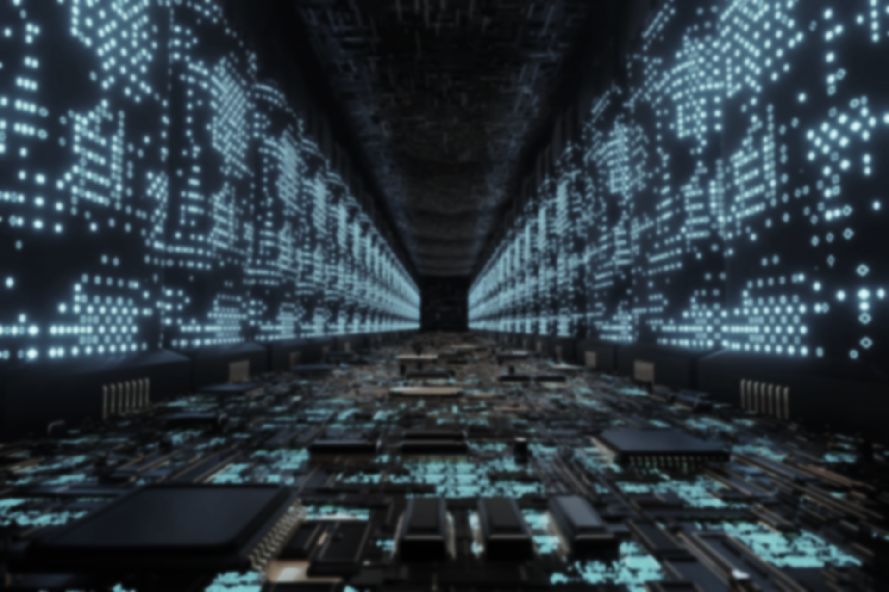



TOSKY Service Expertise
WEB Service
Java (with Spring Framework)
TypeScript
.net Framework
Python
PHP
Mobile App Service
Android (with Kotlin)
iOS (with Swift)
Adobe AIR (with ActionScript 3.0)
RDBMS
Oracle
MSSQL
MySQL
PostgresSQL
MariaDB
No SQL
MongoDB
Redis
Elastic Cache
Server Platform
RHEL
CentOS
Ubuntu
Windows Server
Technology
App promotion
iOS Development
UX/UI Design
Android Development
Data Analysis
R
Python
AWS Athena
Google Analytics
ETC
Event Promotion
UI Design
UX Management
COVERAGE

Slide 11
PORTFOLIO
TOSKY

Slide 12
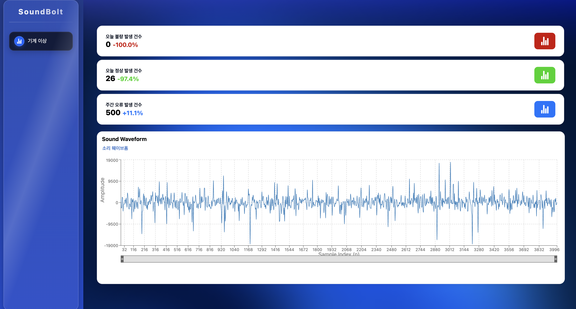
SenseFlow: Defect Detection Using Various Sensors Including Sound and Vibration AISystem
Portfolio
TOSKY
AI-Based Bolt Production Quality Control System Using Noise and Vibration Data was developed.
This system analyzes minute noise and vibration signals generated during the production process in real time to automatically determine bolt defects.
Through deep learning-based analysis models, accuracy and efficiency are significantly improved compared to visual or sample inspections. Immediate alerts are provided when defects are detected, preventing production interruptions and quality degradation in advance. Through this, clients can achieve consistent production quality and cost reduction, smart factory implementation simultaneously.
Service Provider ㈜TOSKY
Client ㈜TOSKY
Period 2025.06~
Google Cloud Platform (GCP)
Compute Engine (VM Instance-Based Service Operation)
Cloud GPU (NVIDIA A100, T4 training etc.·Inference Acceleration)
Cloud Functions (Event-Driven Serverless Architecture)
Cloud Run (Container-Based Scalable Application Deployment)
Vertex AI (Custom Model Training·Deployment and MLOps Support)
Cloud Storage (Training Data and Model Archiving)

Slide 13
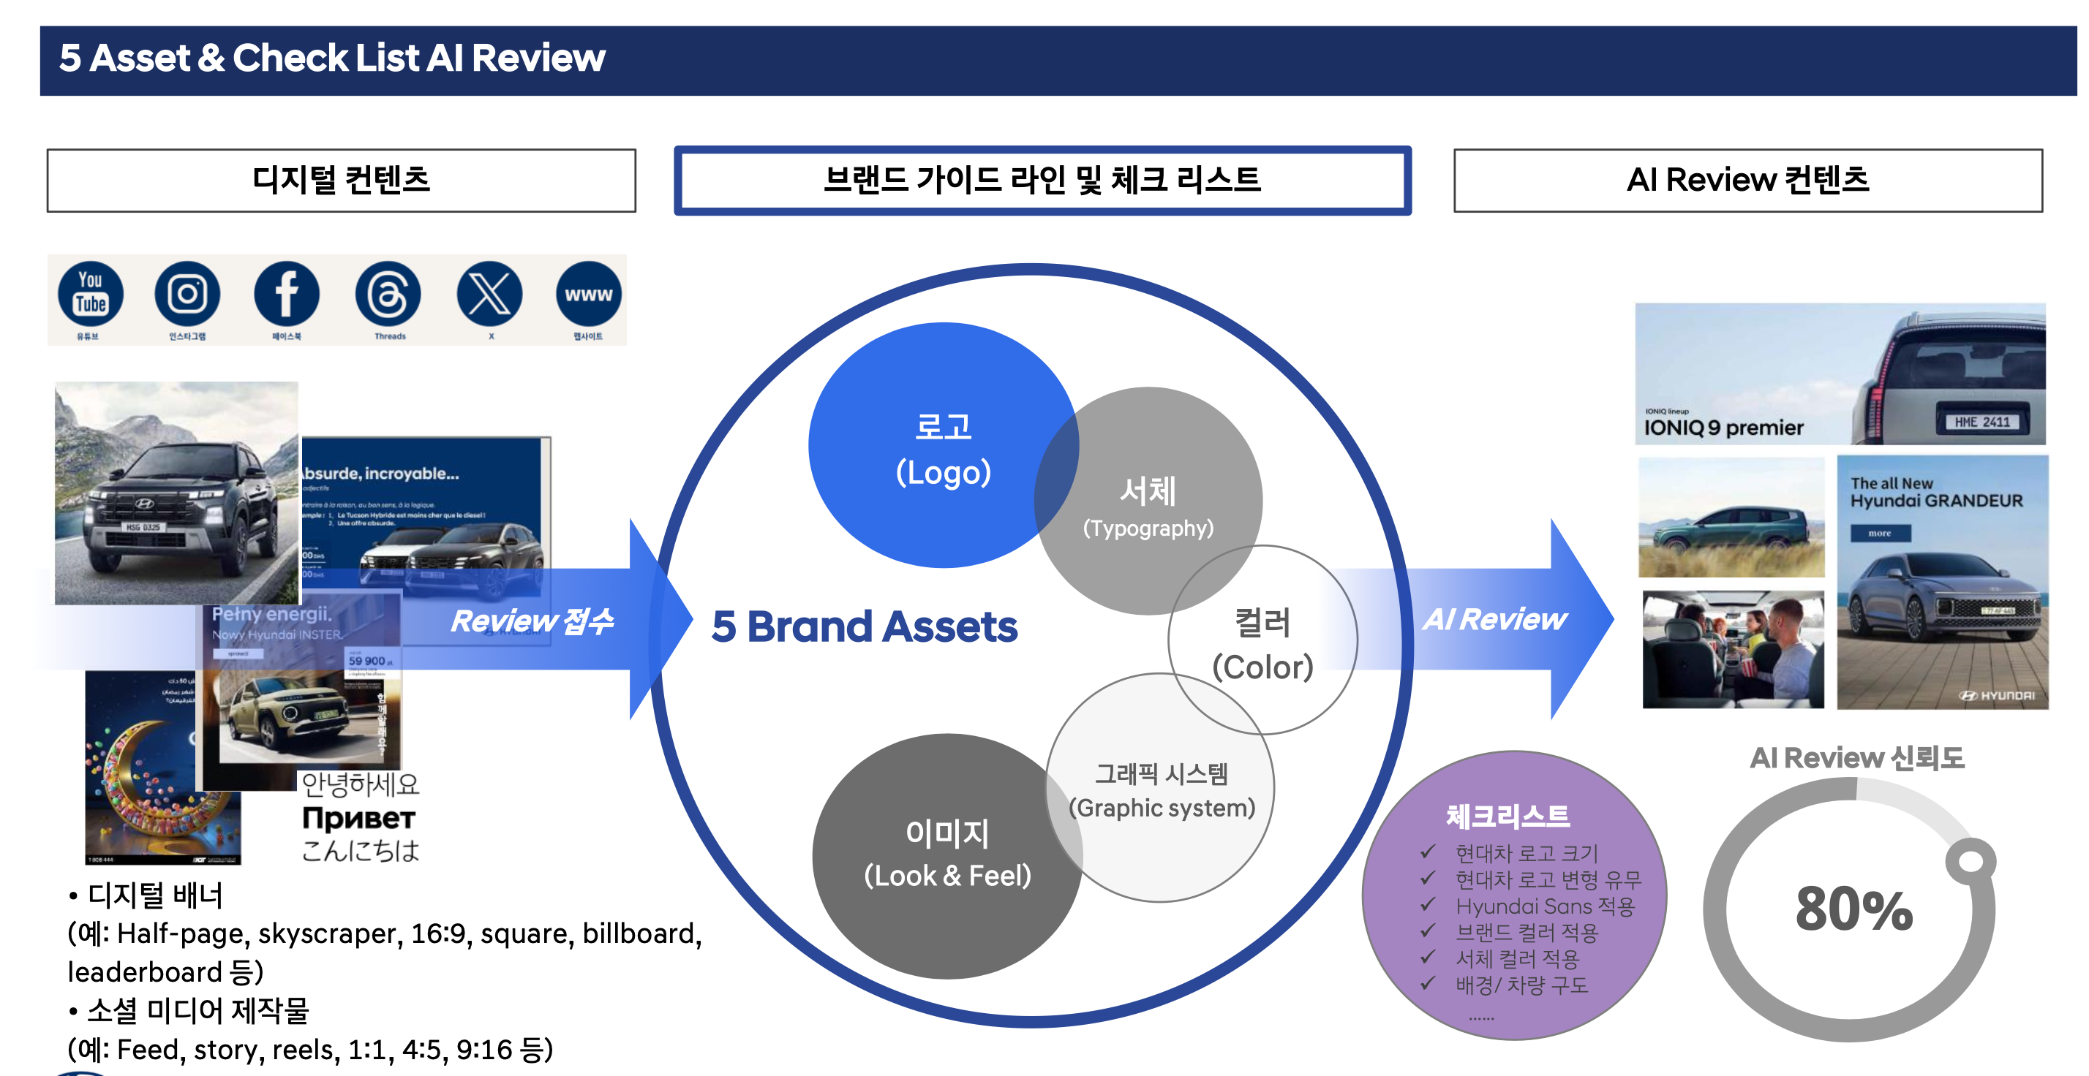
Hyundai Motor BMSSystem: AI Brand Guideline Inspection System
Portfolio
TOSKY
A system that inspects Hyundai Motor's brand manual and guidelines AIusing AI is being developed. This system Vision(image recognition) models and font analysis models(e.g.: Gemini -based)combined to automatically identify visual elements such as logos, colors, and fonts. Following the brand manual, design consistency and regulatory compliance AIare checked in real time by AI. Compared to manual inspection, inspection speed and accuracy are significantly improved. As a result, brand asset management efficiency is enhanced, and global-level brand consistency is maintained is supported.
Service Provider ㈜TOSKY
Client ㈜TOSKY
Period 2025.06~
Google Cloud Platform (GCP)
Compute Engine (VM Instance-Based Service Operation)
Cloud GPU (NVIDIA A100, T4 training etc.·Inference Acceleration)
Cloud Functions (Event-Driven Serverless Architecture)
Cloud Run (Container-Based Scalable Application Deployment)
Vertex AI (Custom Model Training·Deployment and MLOps Support)
Cloud Storage (Training Data and Model Archiving)

Slide 14
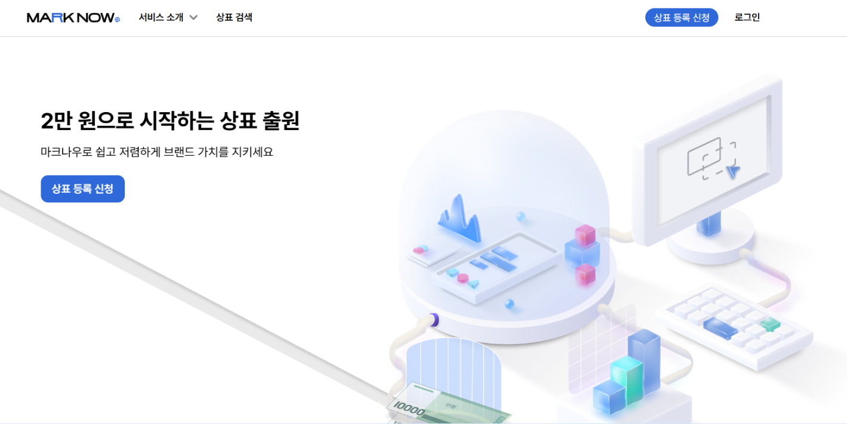
MarkNow: Vision AI-based Trademark Recognition and Image Comparison Model Development
Portfolio
TOSKY
MarkNow is a cutting-edge Computer Vision·platform that utilizes deep learning models to automatically detect trademarks in images(logos·symbols).
Trademark images are AI converted to vector embeddings by the model(Feature Embedding), quantitatively calculating similarity with existing trademarks.
YOLO -series object detection and CNN -based feature extraction networks are combined for precise trademark recognition performance.Data augmentation·and preprocessing techniques are applied, angle·resolution·lighting, and various other conditions maintaining 90% or higher accuracy.
enabling early identification of duplicate trademarks during new trademark registration·and similar trademarks, legal·and administrative review efficiency is significantly improved.
Service Provider TOSKY Inc.
Client TOSKY Inc.
Period 2024.08~
Google Cloud Platform (GCP)
Compute Engine (VM Instance-Based Service Operation)
Cloud GPU (NVIDIA A100, T4 training etc.·Inference Acceleration)
Cloud Functions (Event-Driven Serverless Architecture)
Cloud Run (Container-Based Scalable Application Deployment)
Vertex AI (Custom Model Training·Deployment and MLOps Support)
Cloud Storage (Training Data and Model Archiving)

Slide 15
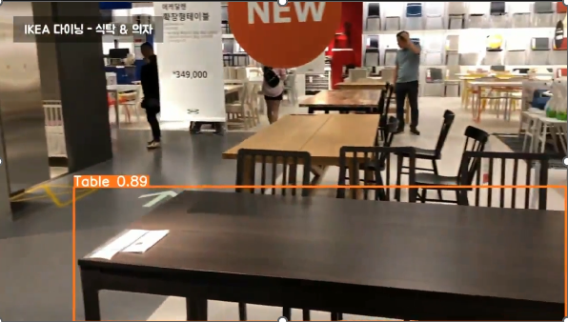
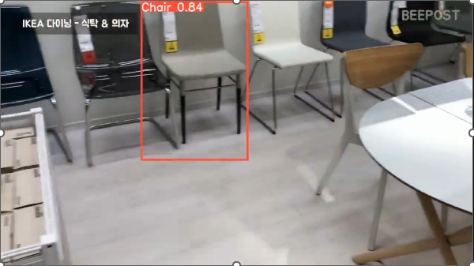
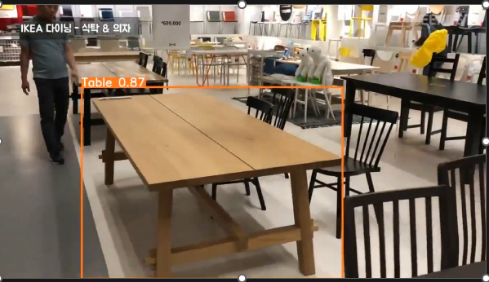
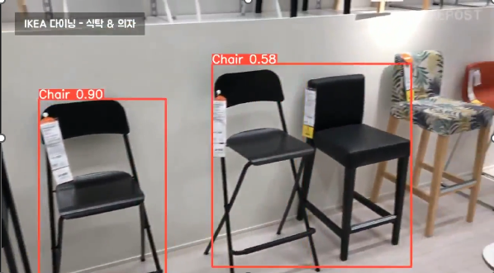
Smart Vision AI: IKEA Store-Based Furniture Object Detection Model Development
Portfolio
TOSKY
This project YOLOv8 -based object detection models to recognize chairs·desks·sofas and other major furniture items·classification technology was developed.
A total of 689furniture image datasets were constructed, IKEA and training was conducted reflecting real environments similar to products.
To address dataset imbalance, training·validation·and test sets were 72:14:14 restructured by ratio to optimize performance.GPU -based 100 epoch Training results, chair 97.8%, sofas 94.7%, desk 93.6% with high AP performance was achieved.
Overall mAP approximately 95.4%, achieving practical application-level accuracy.As an application example, IKEA stable detection in actual store environments was verified using furniture introduction videos.
Initial data bias issues(center-placed, static images)were also improved, enhancing usability across various backgrounds and conditions.
Service Provider TOSKY Inc.
Client TOSKY Inc.
Period 2024.06~
Google Cloud Platform (GCP)
Compute Engine (VM Instance-Based Service Operation)
Cloud GPU (NVIDIA A100, T4 training etc.·Inference Acceleration)
Cloud Functions (Event-Driven Serverless Architecture)
Cloud Run (Container-Based Scalable Application Deployment)
Vertex AI (Custom Model Training·Deployment and MLOps Support)
Cloud Storage (Training Data and Model Archiving)

Slide 16
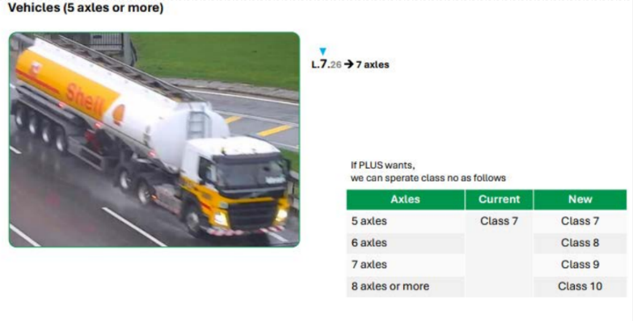
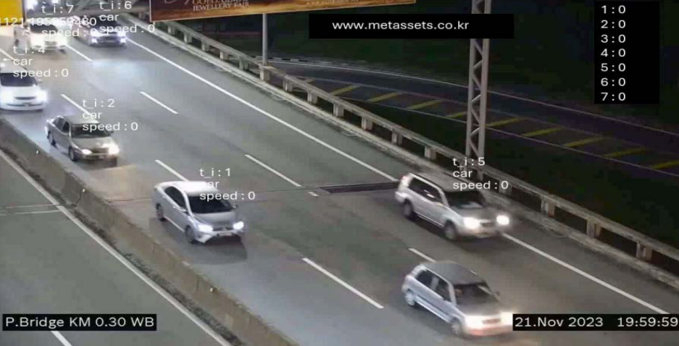
AI Traffic Vision: Malaysia CCTV -Based Vehicle Detection and Traffic Volume Prediction
Portfolio
TOSKY
This project utilizes CCTV video data installed on major roads in Malaysia to build vehicle type object detection and traffic volume prediction models .
YOLO -series models to, trucks·passenger cars·motorcycles, and various vehicle classes for real-time detection.
The acquired video data underwent preprocessing for day·night, weather conditions, and camera angles, designed for stable recognition in various environments.Model performance was measured by class-average accuracy(AP), 90% or higher detection performance was achieved.
Detected vehicle data was combined with time-series analysis techniques for hourly·and vehicle-type traffic volume prediction models.enabling congestion period prediction, road infrastructure efficiency analysis, and traffic policy support was verified.Real-time analysis results are visualized as dashboards, for intuitive monitoring by local traffic authorities.
Service Provider TOSKY Inc.
Client TOSKY Inc.
Period 2022.03~
Google Cloud Platform (GCP)
Compute Engine (VM Instance-Based Service Operation)
Cloud GPU (NVIDIA A100, T4 training etc.·Inference Acceleration)
Cloud Functions (Event-Driven Serverless Architecture)
Cloud Run (Container-Based Scalable Application Deployment)
Vertex AI (Custom Model Training·Deployment and MLOps Support)
Cloud Storage (Training Data and Model Archiving)

Slide 17
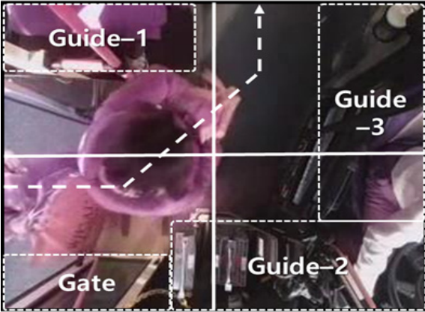
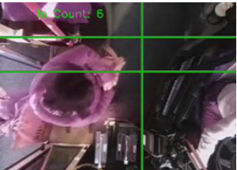
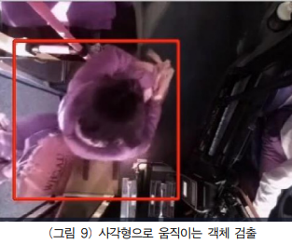
SmartBus Vision: AI -Based Boarding·and Alighting Passenger Count System
Portfolio
TOSKY
This system utilizes cameras installed inside buses and video analysis algorithms, Boarding·to automatically count alighting passengers as a smart mobility solution.
AI -based detection technology calculates boarding and alighting passengers in real time, based on which hourly·and route-based boarding pattern data can be collected.
Collected data is combined with congestion monitoring, designed to identify passenger-dense segments and improve operational efficiency.reducing the manual counting burden on transport companies and drivers, enabling operation optimization and dispatch adjustments based on passenger congestion.
Service Provider TOSKY Inc.
Client TOSKY Inc.
Period 2022.03~
Google Cloud Platform (GCP)
Compute Engine (VM Instance-Based Service Operation)
Cloud GPU (NVIDIA A100, T4 training etc.·Inference Acceleration)
Cloud Functions (Event-Driven Serverless Architecture)
Cloud Run (Container-Based Scalable Application Deployment)
Vertex AI (Custom Model Training·Deployment and MLOps Support)
Cloud Storage (Training Data and Model Archiving)

Slide 18
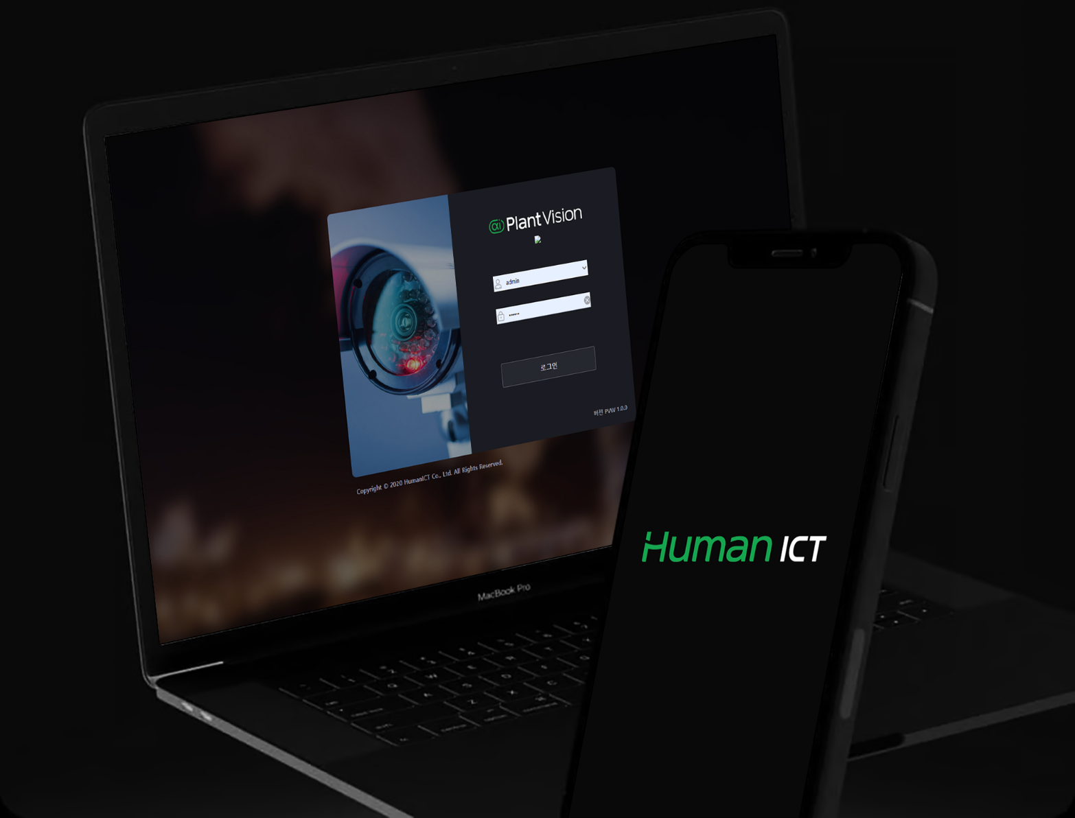
Human ICT AI Vision Management System MSA Development
Portfolio
HumanICT
AI Vision system is a Human ICT-developed Vision-based hazard detection system.
The AI Vision model was used as the basis for performance optimization.
Additionally, the existing Monolithic architecture previously built management site was migrated to MSA.
The Python-based built ML parts and communication server were deployed with k8s processes deployed. The Java-based written management site was deployed with Multi Tenant.
Service Provider ㈜TOSKY
Client HumanICT
Period 2021.11~2022.03
Responsibilities
Development/Architecture
Development Environment
Java 11 (with spring Boot),Mysql,Python,k8s,lambda,docker

Slide 19
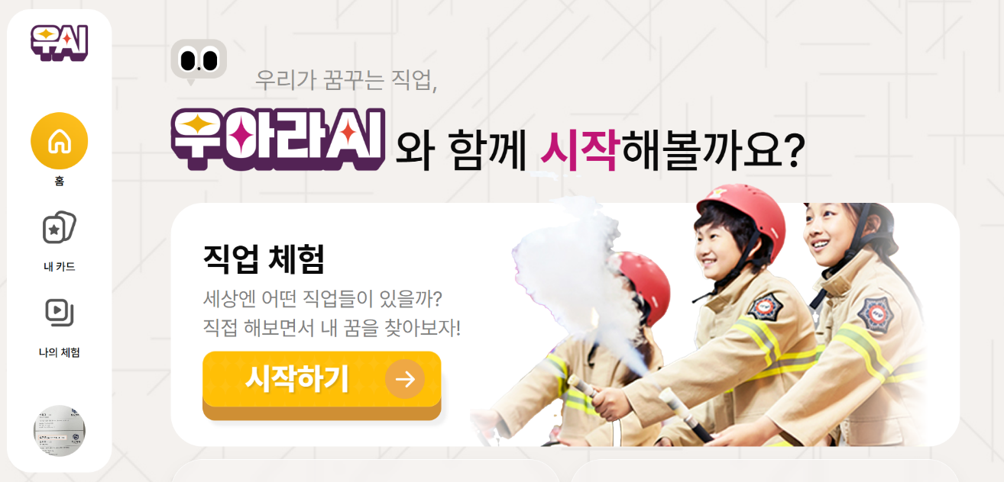
Woori AI Life(WOARAAI)
Portfolio
TOSKY
WOARA AI is a cutting-edge generative LLM(Large Language Model)-based learning·assessment·and career exploration intelligent teaching and learning platform.
This system goes beyond simple Q&A, with customized question generation and answer evaluation tailored to user level and purpose. For example, it can automatically generate math problems and grade answers to diagnose learner comprehension, present career-specific scenario questions and analyze responses to evaluate aptitude and job tendencies.
WOARA AI fostering learners' creative problem-solving skills, teachers·students·working professionals and various educational·training settings. Furthermore, occupation-specific questions·through task design for career exploration, job competency enhancement, lifelong learningas an expandable next-generation AI educational service.
In particular, LLM leveraging accumulated data enables expansion into customized curriculum recommendations, corporate-linked job training, and personalized learning growth reports, across the education industry and HRD(Human Resource Development) fields creating innovative value.
Service Provider TOSKY Inc.
Client TOSKY Inc.
Period 2025.03~
Google Cloud Platform (GCP)
Compute Engine (VM Instance-Based Service Operation)
Cloud GPU (NVIDIA A100, T4 training etc.·Inference Acceleration)
Cloud Functions (Event-Driven Serverless Architecture)
Cloud Run (Container-Based Scalable Application Deployment)
Vertex AI (Custom Model Training·Deployment and MLOps Support)
Cloud Storage (Training Data and Model Archiving)

Slide 20
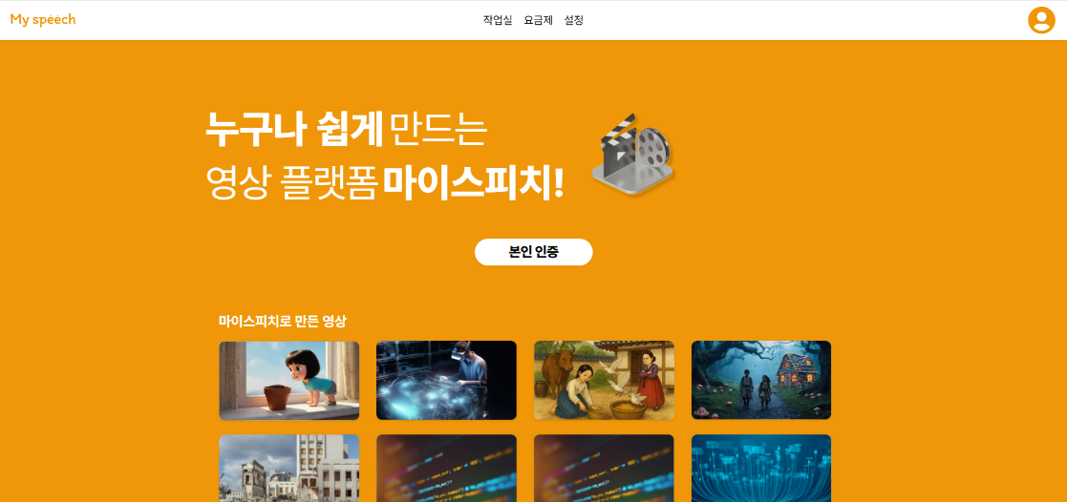
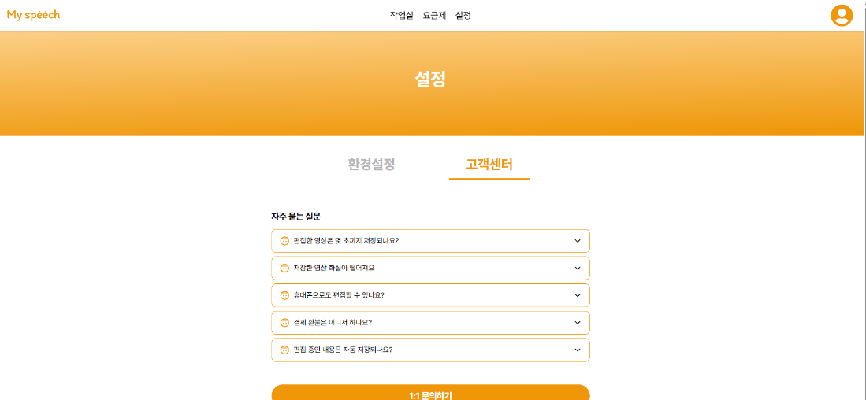
My Speech(AIVideo Production) In-House Platform Construction
Portfolio
TOSKY
My Speech is designed for anyone to easily and quickly produce high-quality videos as an AI -based video production platform.
OpenAI Sora, Google DeepMind Veo and other latest video AI models integrated, users can generate short video clips from text input alone.
Generated videos can be intuitively assembled through drag-and-drop editing within the platform.Users can apply background music insertion, automatic subtitle generation, transitions and other effects to achieve professional-level quality.
Without specialized video editing knowledge, general users, corporate marketers, and creators can quickly produce·and distribute content.This service can be used for educational content, product promotion, SNS short-form production and various other fields.
The goal is to build a video production ecosystem accessible to anyone by lowering the barrier compared to professional editing tools.In the future, AI narration(TTS), Image·automatic text summary insertion, and real-time collaboration features will be added, as a next-generation One-Stop video production platform.
Service Provider TOSKY Inc.
Client TOSKY Inc.
Period 2025.03~
Google Cloud Platform (GCP)
Compute Engine (VM Instance-Based Service Operation)
Cloud GPU (NVIDIA A100, T4 training etc.·Inference Acceleration)
Cloud Functions (Event-Driven Serverless Architecture)
Cloud Run (Container-Based Scalable Application Deployment)
Vertex AI (Custom Model Training·Deployment and MLOps Support)
Cloud Storage (Training Data and Model Archiving)

Slide 21
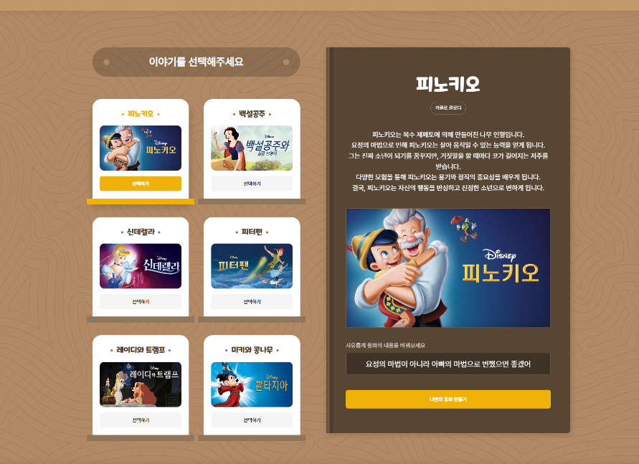

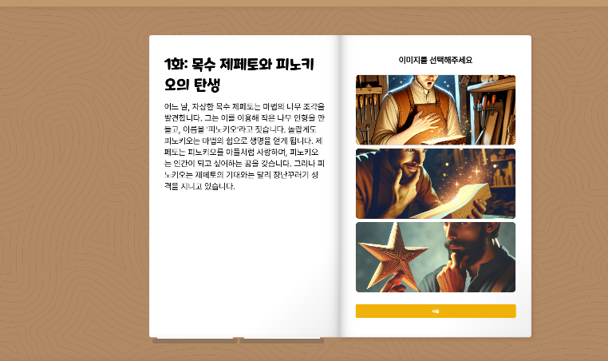
Generative Fairy Tale shorts System Development
Portfolio
TOSKY
A system was built to produce videos from various fairy tale stories using generative AI.
Various images and fairy tale stories are generated by generative AI, AIvoice can use the user's own learned voice, or celebrity voices trained to narrate fairy tales AIby voice.
Using the generated images and voice, short shorts-format content is created, which can be shared on YouTube or played on the in-house platform for educational purposes for children.
Service Provider ㈜TOSKY
Client ㈜TOSKY
Period 2024.10~
Responsibilities
Planning/Design/Development/AI Voice Generation, etc.
Development Environment
AWS ECS, Cognito, S3, Amplify, API Gateway, RDS, CloudWatch

Slide 22

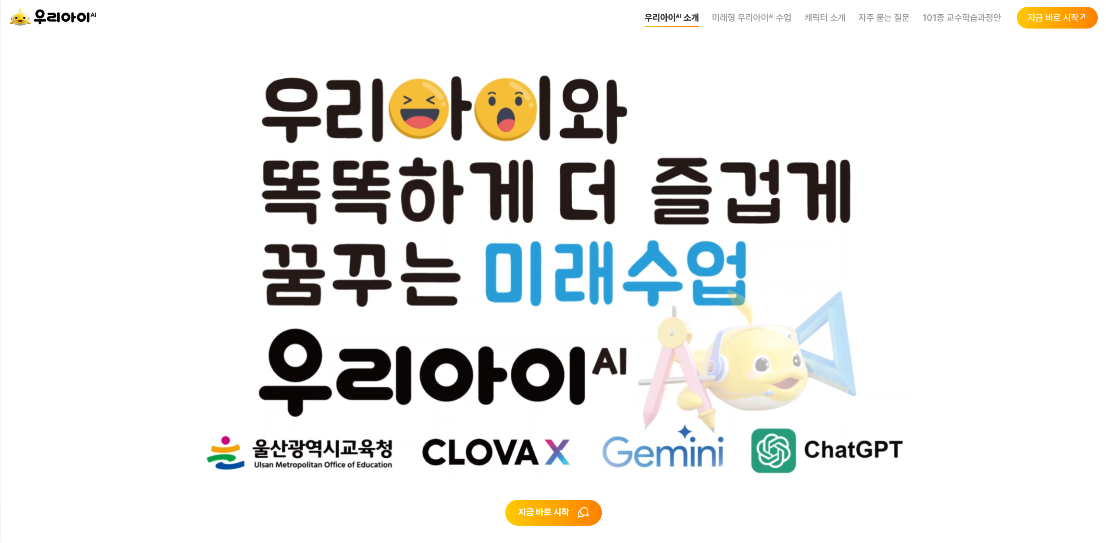
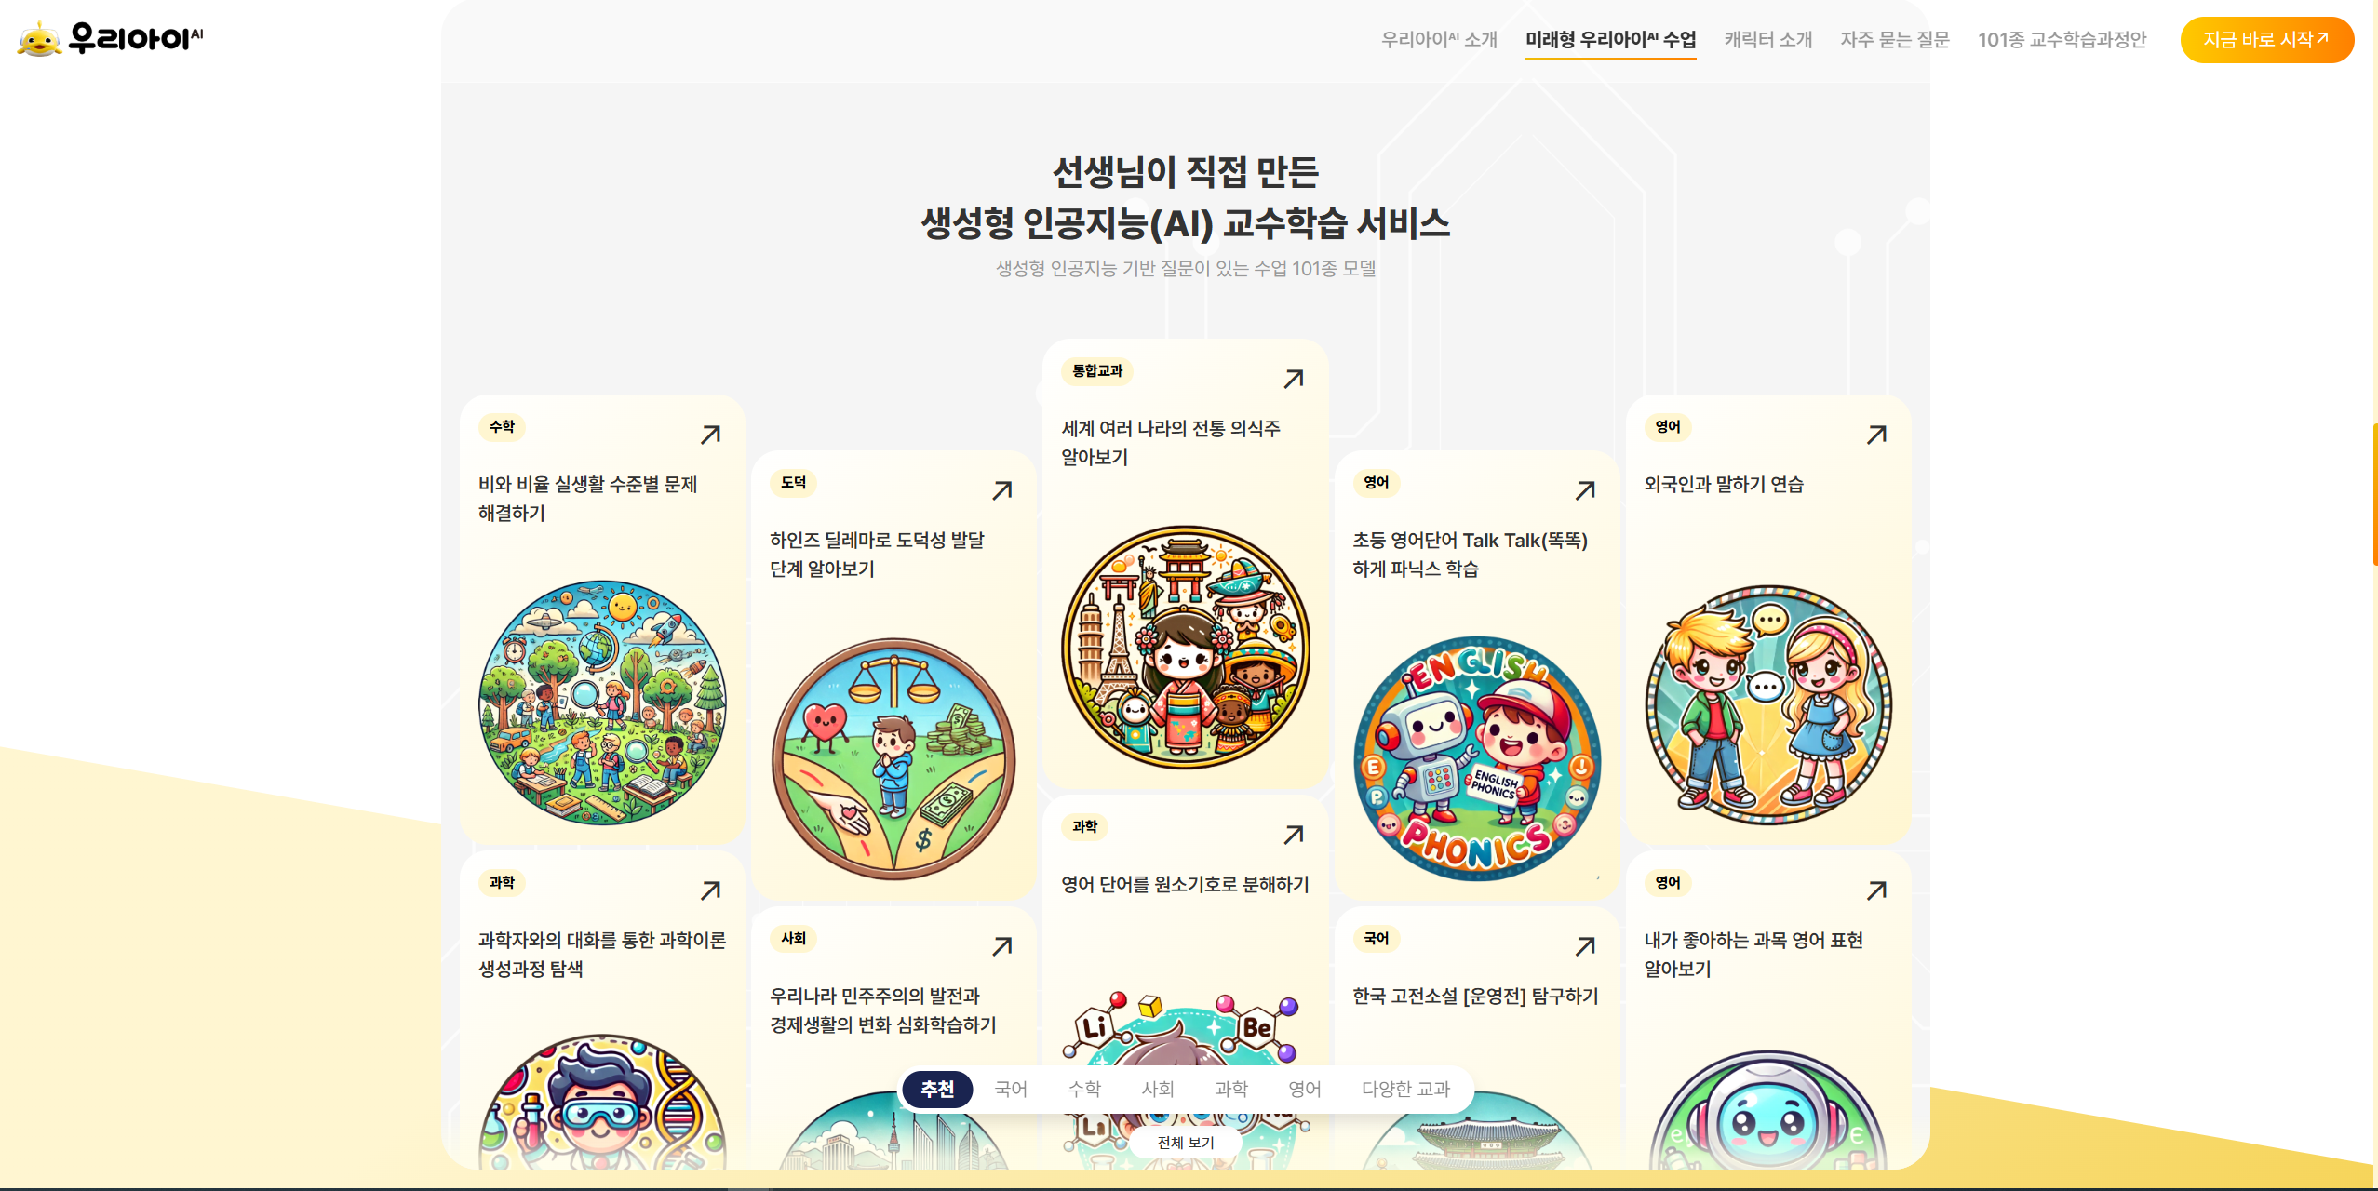
Ulsan Office of Education 'Woori AI' Development
Portfolio
Ulsan Office of Education
Woori AIAI is developed by Ulsan Metropolitan Office of Education as an AI-based teaching and learning platform, providing personalized learning experiences tailored to each student's level and needs as a customized learning experience are provided.
This service covers Korean, Mathematics, Social Studies, Science, English and other major subjects, A total of 101 types of 'Lessons with Questions' learning models are equipped. enabling students to experience thinking-centered learning rather than simple memorization, fostering proactive and active learning attitudes.
Additionally, Bespin Global's HelpNow solutionthis system implemented with the solution provides immediate and accurate answers when students enter questions, providing practical assistance even in solving complex problems. enabling students' self-directed learning, as well as useful for teacher instruction support and learning data analysis.
Service Provider ㈜TOSKY
Client Ulsan Office of Education
Period 2024.08~
Responsibilities
Site Design and Construction
Development Environment
Chat Interface based multi LLM

Slide 23
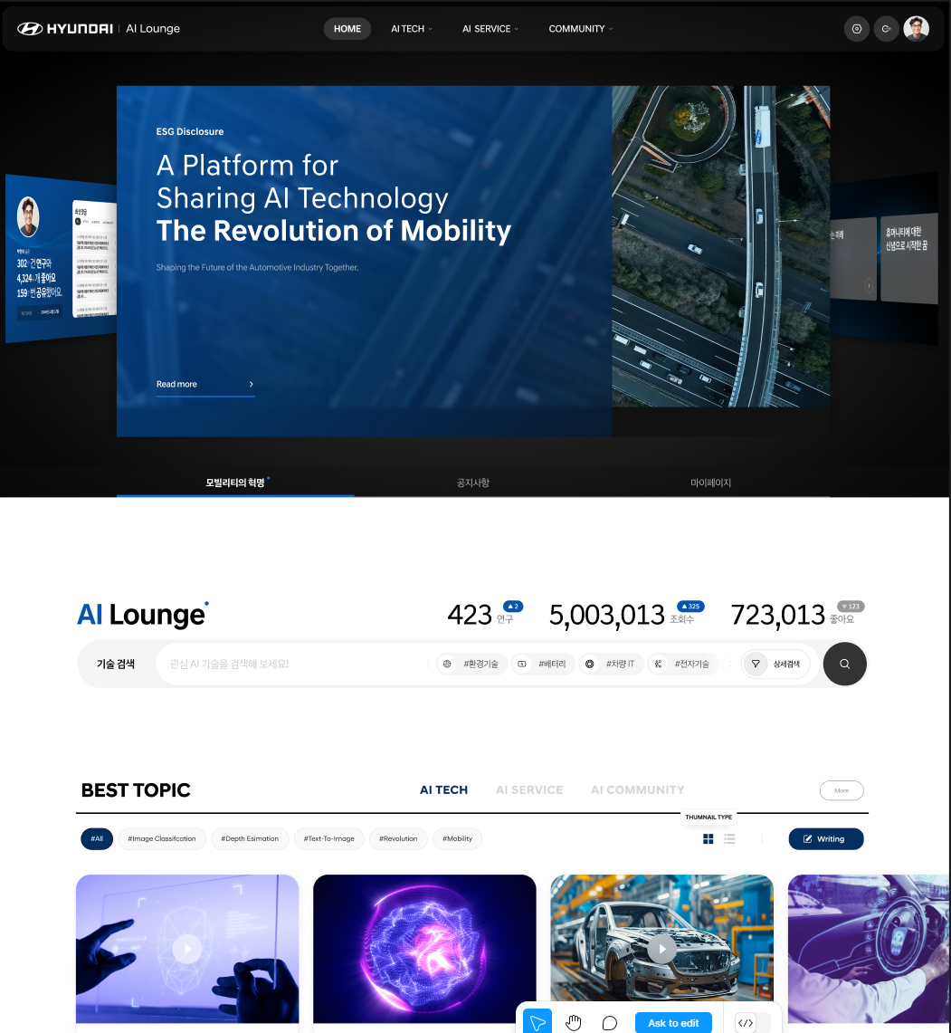
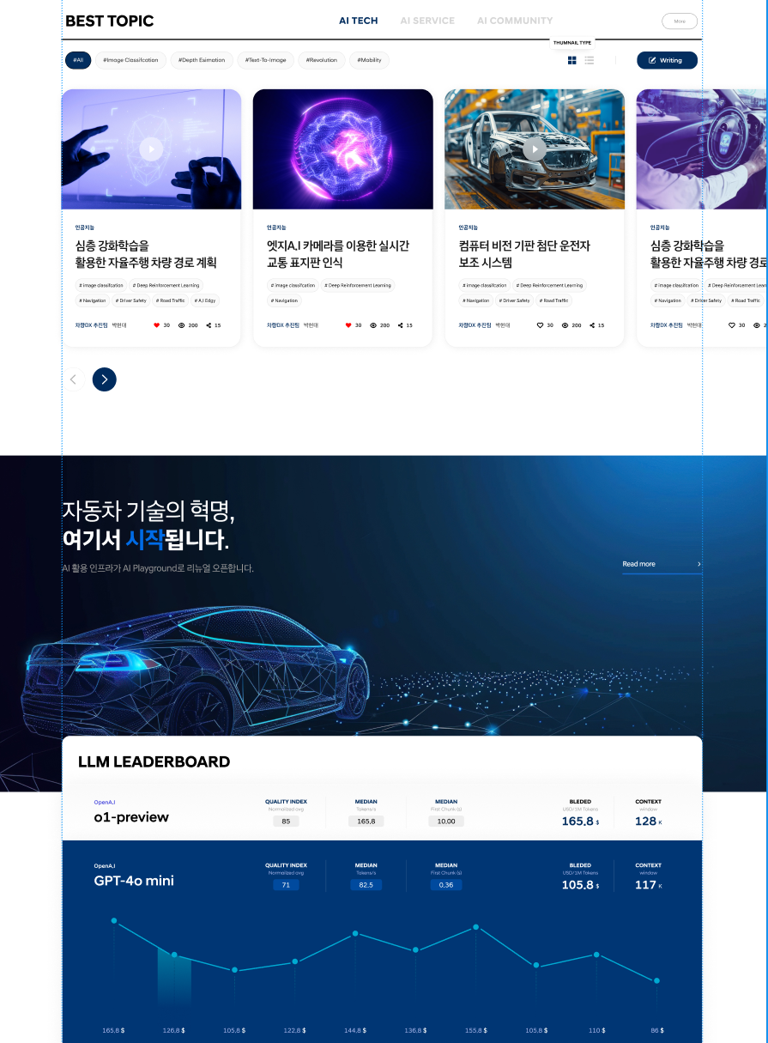
AI Rounge Service Development
Portfolio
Hyundai Motor Group
AI Lounge is a service for integrated management of Hyundai Motor's AI assets, supporting seamless asset sharing and communication between departments.
This service LLMprovides efficient content creation features including image generation and content summarization.
strengthening inter-departmental collaboration and AI maximizing asset utilization.
Service Provider ㈜TOSKY
Client Hyundai Motor
Period 2024.10~
Responsibilities
Planning/Design/Development
Development Environment
AWS ECS, Cognito, S3, Amplify, API Gateway, RDS, CloudWatch

Slide 24
Generative Content Convergence and Generation
Portfolio
Hyundai Motor Group X Google
In collaboration with Google, Hyundai Motor's various technology assets LLMare summarized, translated, and restructured, Generative creating content including images and videos as a PoC project.
Beyond simple content creation YouTube various videos are searched to expose competitor technology trends and customer reaction summaries,Hyundai Motor's pre-acquired various technology assets based related papers are add-onto produce complex content by converging information.
Service Provider ㈜TOSKY
Client Hyundai Motor
Period 2025.02~
Responsibilities
Generative AIContent Creation Automation Using
Development Environment
AWS ECS, Cognito, S3, Amplify, API Gateway, RDS, CloudWatch

Slide 25
Database and Multi-System Document Search and Utilization
Portfolio
Hyundai Motor Group X Google
In collaboration with Google, Hyundai Motor's various data(ERP,HR,various system databases)are all converged, regardless of data type, databases and pdf,pptxand other documents are all converged for integrated search.
Through this, document-based search, video,image searches can all be smoothly processed as an integrated search system PoC project.
Service Provider ㈜TOSKY
Client Hyundai Motor
Period 2025.02~
Responsibilities
Based on Various Data Sources Elastic Search
Development Environment
AWS ECS, Cognito, S3, Amplify, API Gateway, RDS, CloudWatch

Slide 26
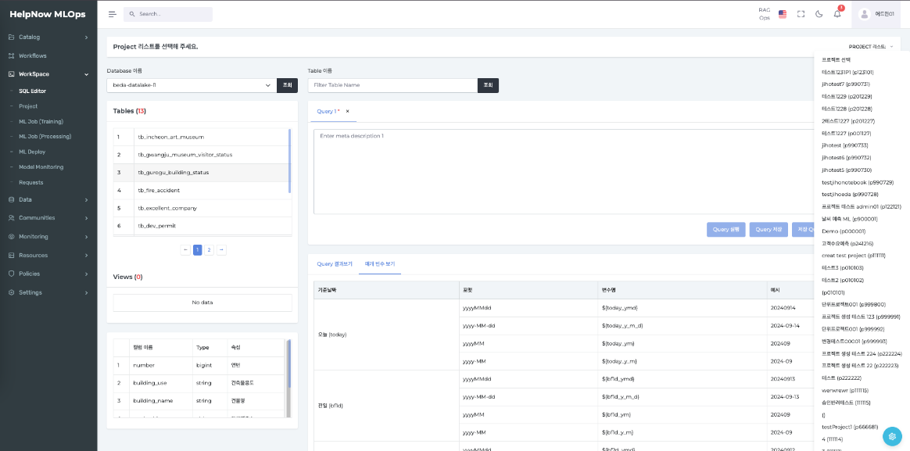
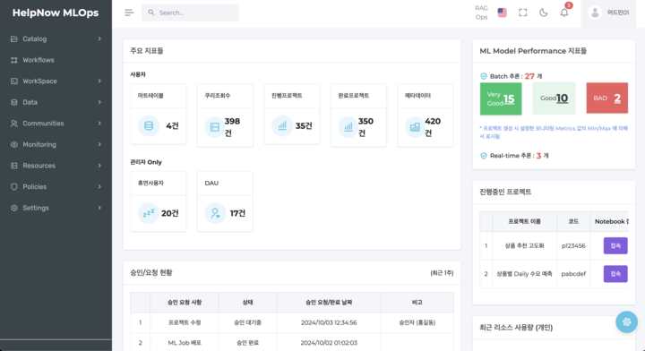
AI Data-Based Model Training Portal Service Development
Portfolio
TOSKY
Various AI models require training data. Such training data is primarily based on data extracted from big data systems, The AI data portal system automatically extracts and classifies data obtained from these big data systems, for models to learn from automatically classified data.
Pipelines for training and model evaluation based on auto-classified data can be created by permission level, with evaluation per pipeline for efficient data-based model training .
Service Provider ㈜TOSKY
Client ㈜Bespin Global
Period 2024.12~
Responsibilities
Planning/Design/Development
Development Environment
AWS SageMaker,ECS, Cognito, S3, Amplify, API Gateway, RDS, CloudWatch

Slide 27
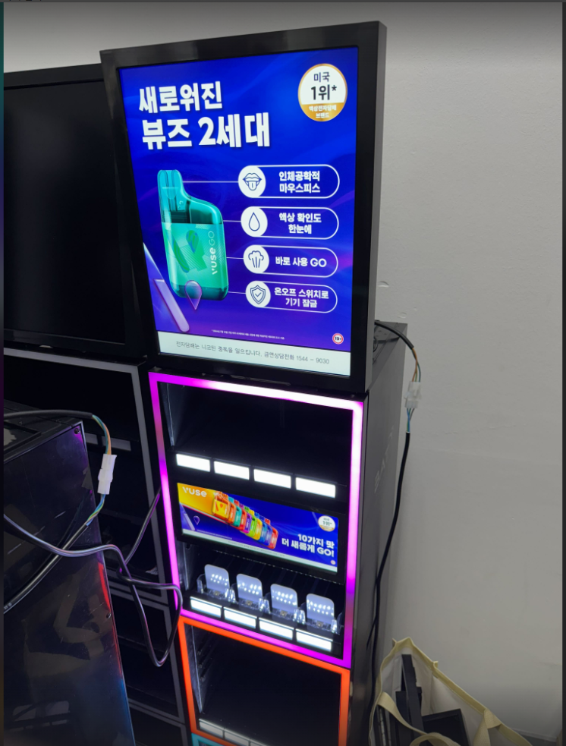
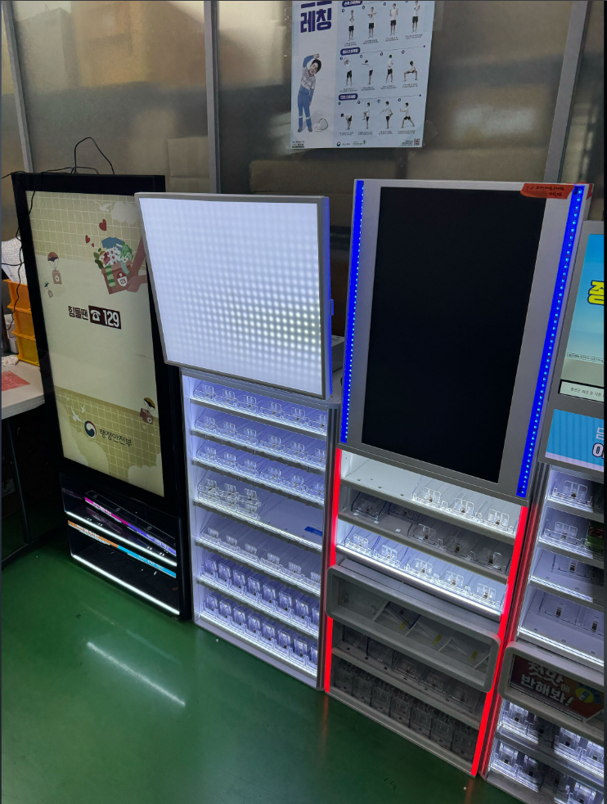
Dynamic Advertising System Development
Portfolio
POSI & PMK
A Dynamic advertising system delivered to various convenience stores was developed. by region/by time/and by schedule for ad display, even in unstable system environments seamless ad display is enabled with zero-downtime service.
The advertising system supports various Android-based screens and can efficiently display ads by grouping them.
Ad videos and images can be replaced in real time through online updates, and real-time alerts enable immediate administrator action when module anomalies are detected.
Service Provider ㈜TOSKY
Client PMK
Period 2024.10~
Responsibilities
Planning/Design/Development
Development Environment
AWS ECS, Cognito, S3, API Gateway, RDS, CloudWatch

Slide 28
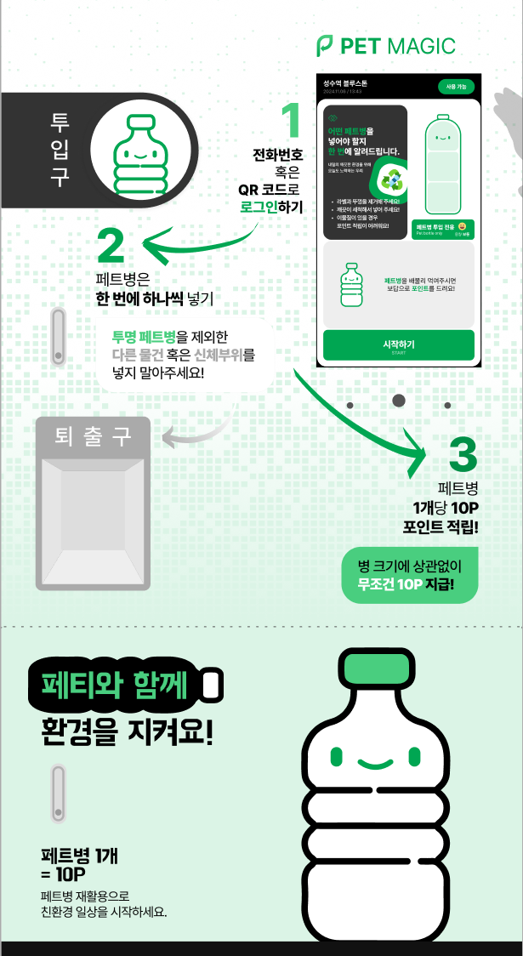
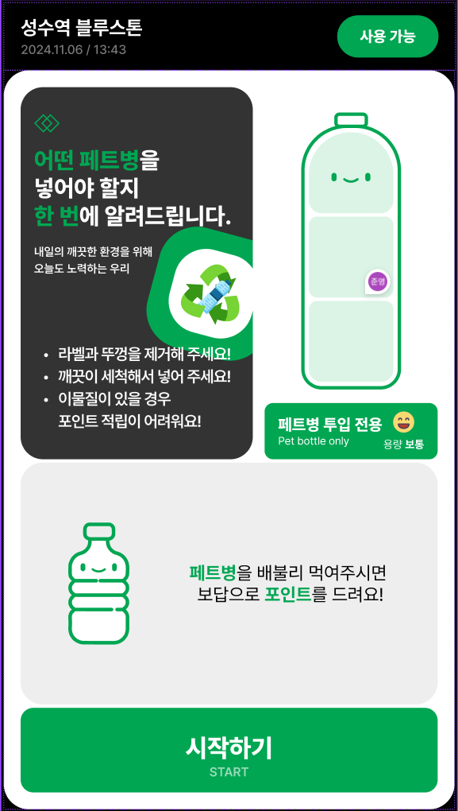
Smart Pet Grinder System Development
Portfolio
SPG Group
Smart Pet Grinder accepts recycled PET bottles and uses AI to determine whether foreign materials such as caps are present, accepting only pure Petbottles intake and reprocessing them into pellets as raw materials for recycled plastic in an innovative recycling machine.
TOSKY targeting the main age group of 30~50's Needs with an easy-to-use UI/UX as the basis
earned points can be linked with Starbucks,E-Mart, and others to lead efficient recycling collection.
Service Provider ㈜TOSKY
Client SPG Group
Period 2024.11~
Responsibilities
Planning/Design/Development
Development Environment
AWS ECS, Cognito, S3, Amplify, API Gateway, RDS, CloudWatch

Slide 29
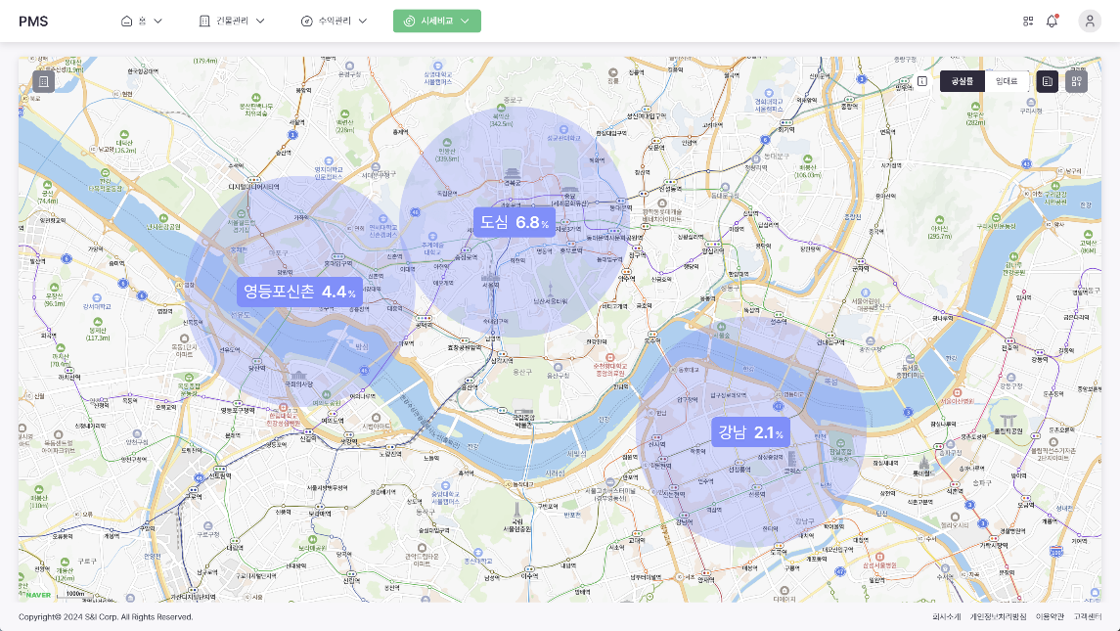
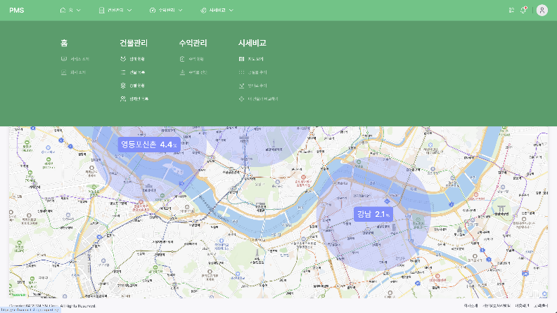
Property Management System Service Development
Portfolio
SNI Corporation
A comprehensive real estate asset management system for clients. Revenue dashboards diagnose current return rates against targets and recommend solutions to improve and optimize revenue.
Based on advanced analysis results and trending industry information, contracts are efficiently managed and clients' similar building status is monitored in real time. Additionally, Contract Status, Financial Statements, marketing management functions for systematic asset Portfolio management.
Service Provider ㈜TOSKY
Client SNI Corporation
Period 2024.03~
Responsibilities
Planning/Design/Development
Development Environment
AWS ECS, Cognito, S3, Amplify, API Gateway, RDS, CloudWatch

Slide 30
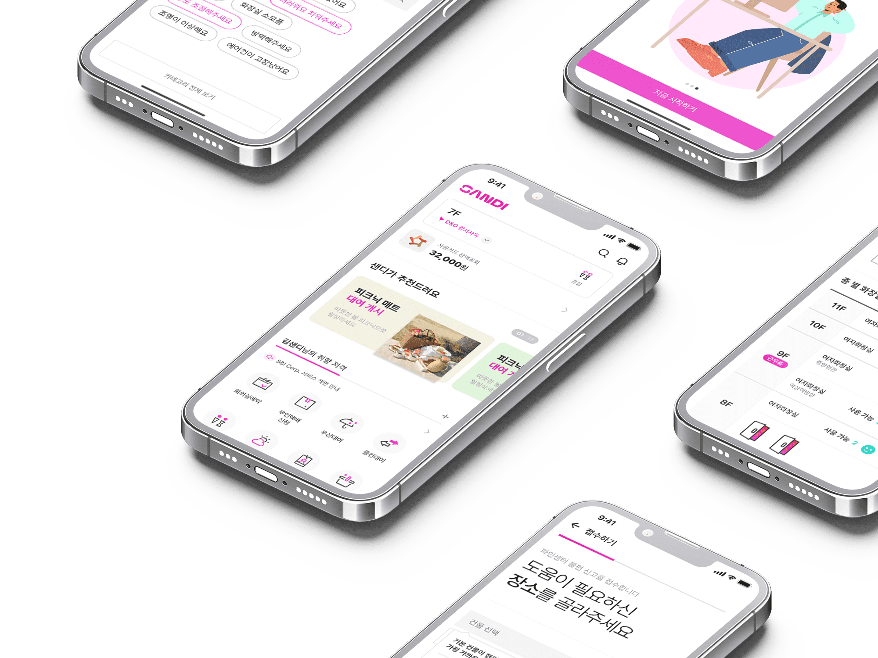
SANDI 2.0 Application Service Development
Portfolio
SNI Corporation
AWS IoT Core using temperature/humidity sensors/restroom sensors/air quality sensor-based integration was performed.
Infrastructure is based on MSAarchitecture implemented with ECS. Agile methodology was applied with domain-specific scrum structure for project execution.
Service Provider ㈜TOSKY
Client SNI Corporation
Period 2022.08~
Responsibilities
Planning/Design/Development/Architecture Construction
Development Environment
AWS IoT Core, ECS, Java, Postgresql

Slide 31
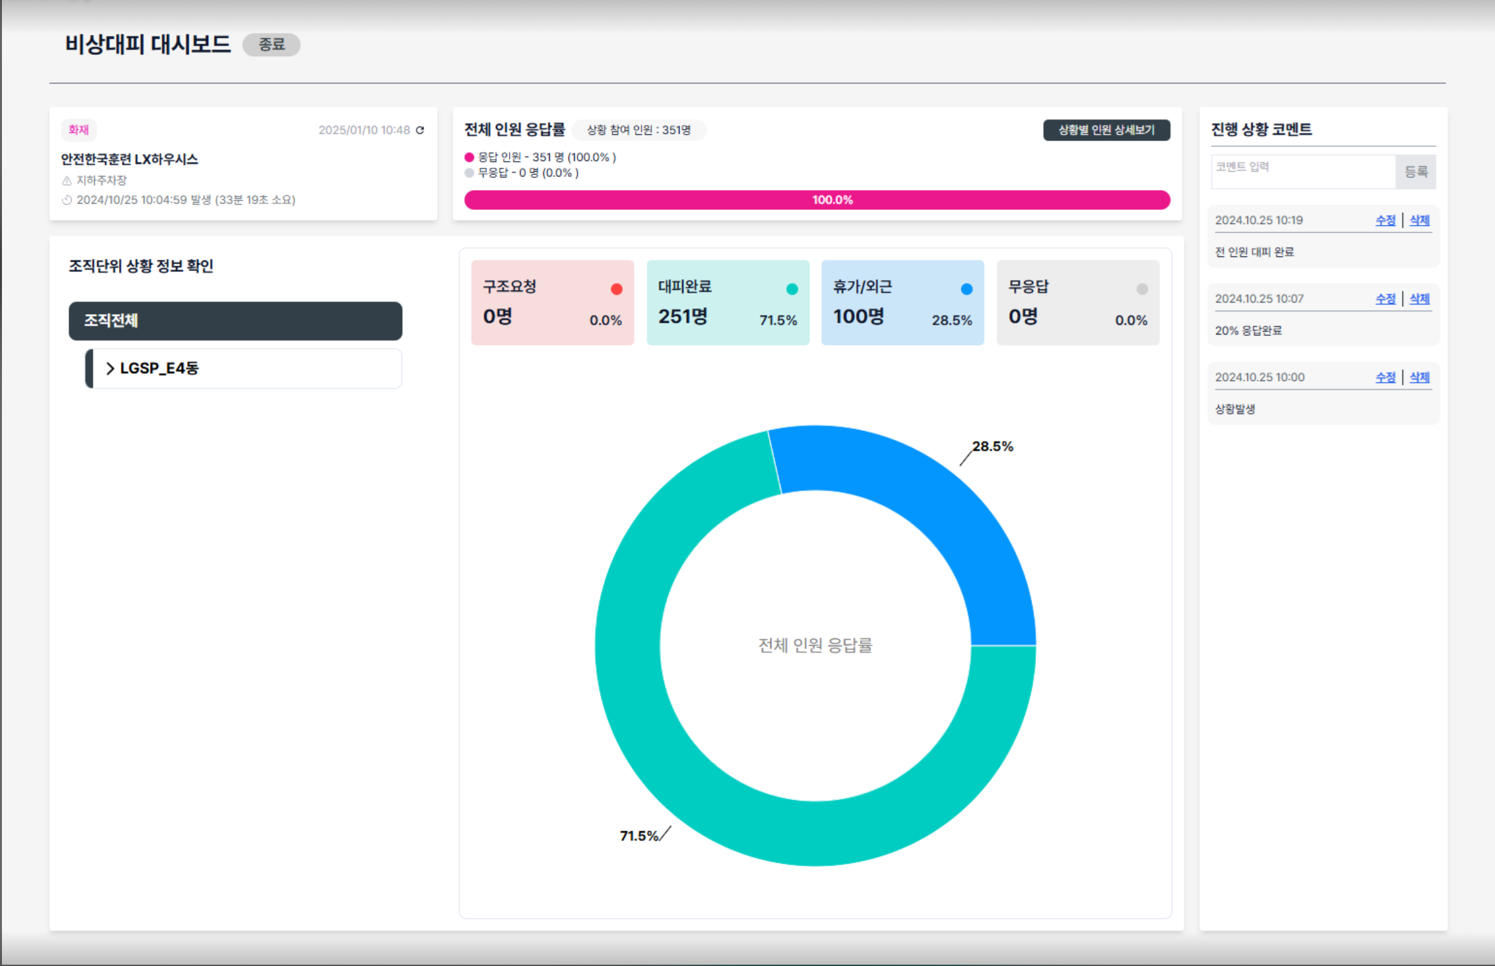
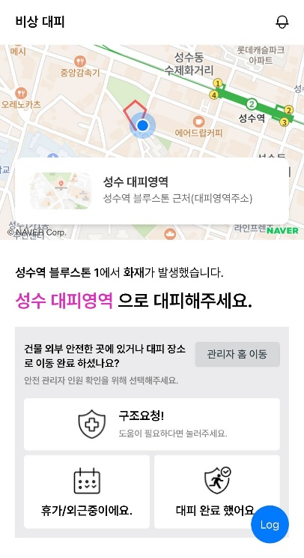
SANDI 2.0 Emergency Evacuation Service Development
Portfolio
SNI Corporation
In emergency situations such as fires, an emergency evacuation system was developed for rapid identification of evacuees and real-time evacuation status monitoring.
When an emergency occurs, the system starts with notification alerts, pushand other situation broadcasts, continuously monitoring and controlling evacuees efficiently during the situation identification is the key feature.
LG Electronics/ U+/ Innotek and other 2ten thousand personnel were trained in emergency evacuation drills, with the system's stability and efficiency recognized
Service Provider ㈜TOSKY
Client SNI Corporation
Period 2022.08~
Responsibilities
Planning/Design/Development/Architecture Construction
Development Environment
AWS IoT Core, ECS, Java, Postgresql

Slide 32
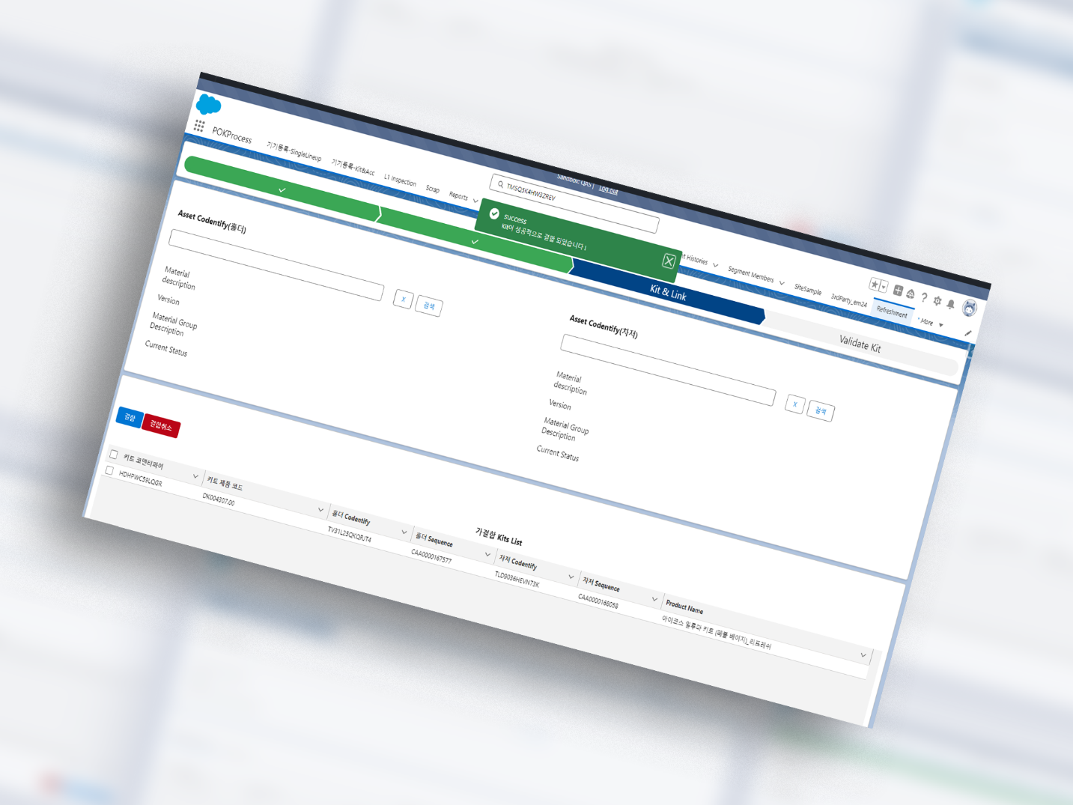

LIC Refreshment System Service Development
Portfolio
Philip Morris Korea(PMK)
LIC Refreshment The project LIC Inspection aims to increase sales through feature expansion and renewable energy growth with Asset Life-Cycle Report (iTrack) automation and Total CRM System was constructed. Asset – Qure – Caseconnected through Customer Care system with Refreshed concepts introduced.
Refresh Device information is viewable at a glance with device, kit, and delivery information output in desired format. Salesforce was used to build the system.
Service Provider ㈜TOSKY
Client Philip Morris Korea
Period 2024.03 ~
Responsibilities
Development
Development Environment
Salesforce

Slide 33
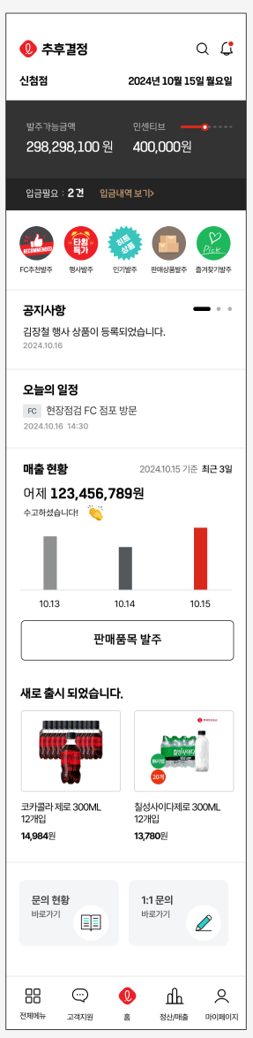
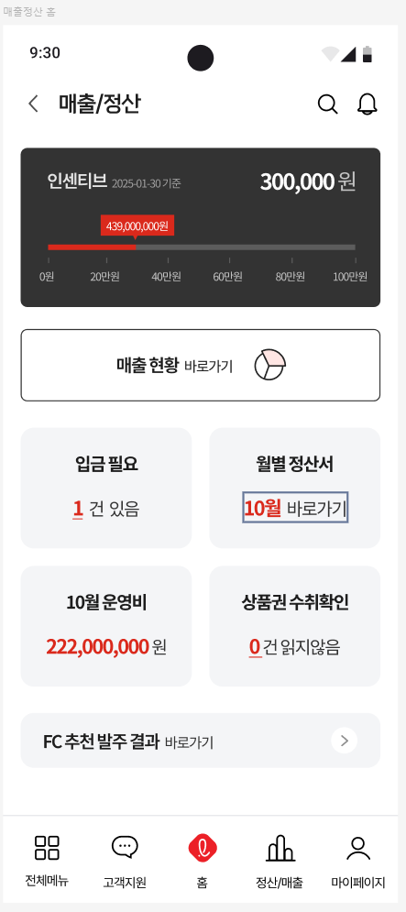
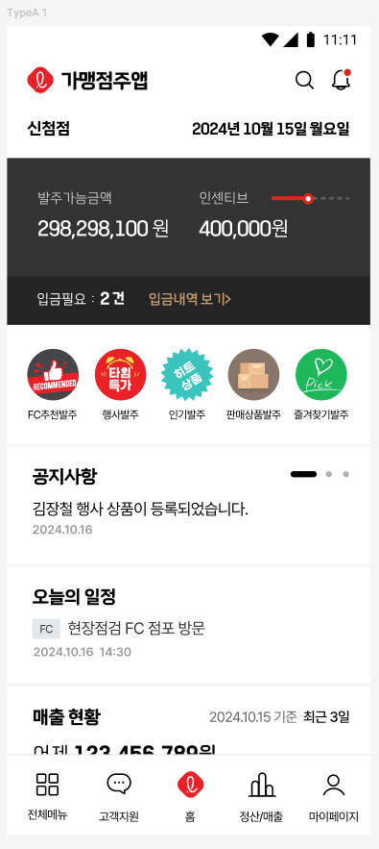
Lotte Super & Mart Integrated Ordering System Service Development
Portfolio
Lotte Mart
This project was needed as Lotte Super and Mart ERPintegrated their systems, requiring a unified product ordering system for store owners.
TOSKY An integrated ordering application was developed for store owners to conveniently place unified orders.
Service Provider ㈜TOSKY
Client Lotte Mart
Period 2024.07 ~
Responsibilities
Development
Development Environment
Salesforce

Slide 34
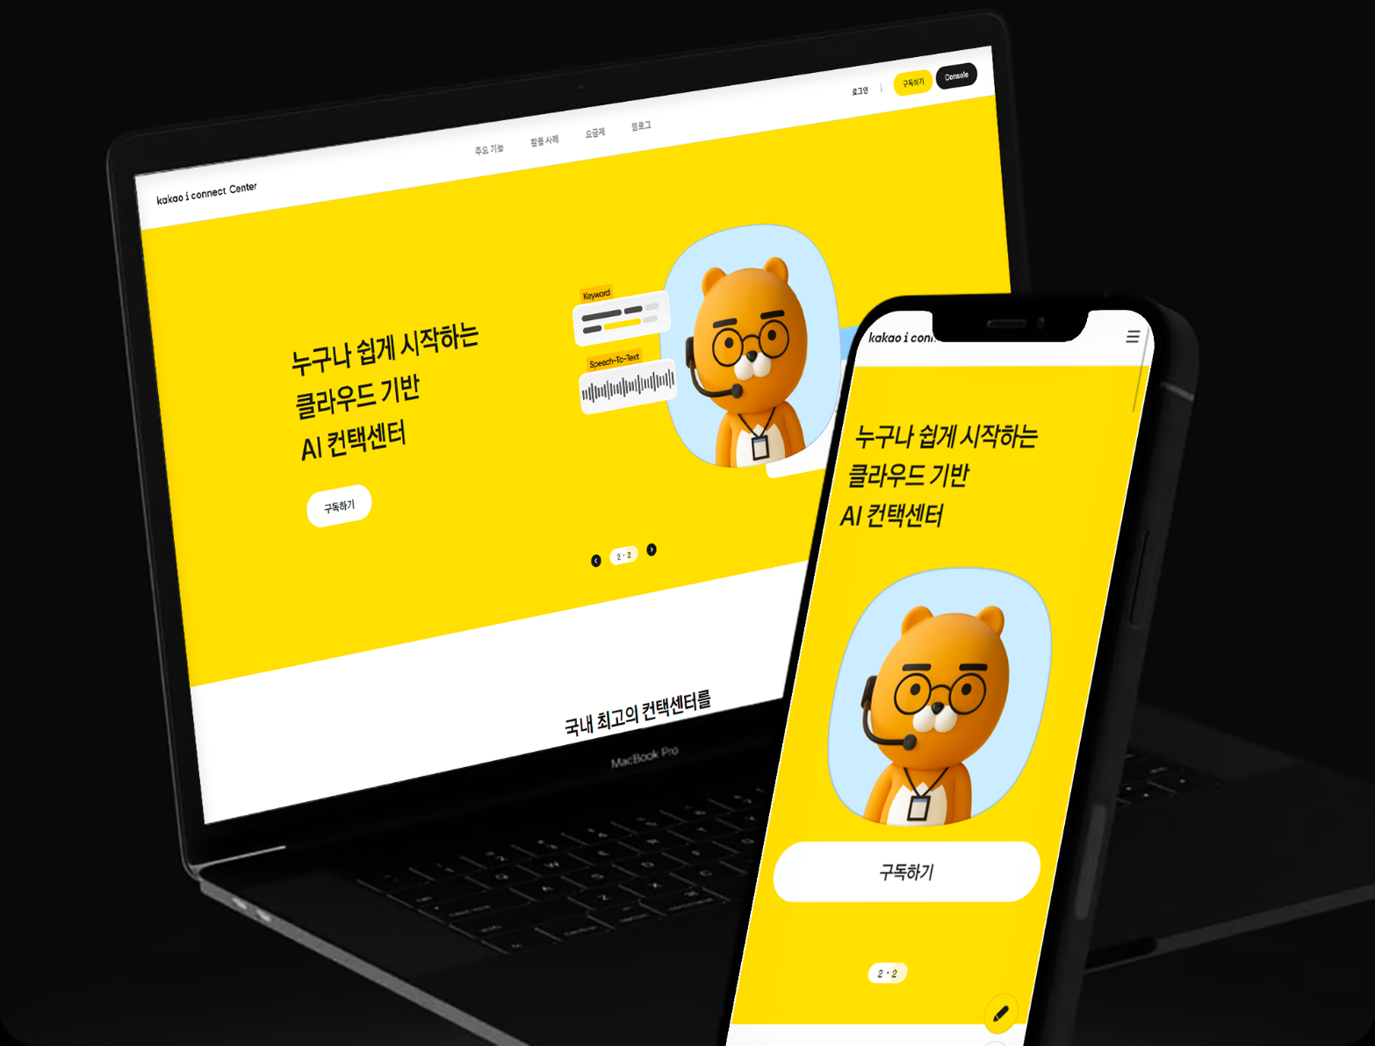
Kakao Enterprise i-Connect Center Console Development/Maintenance
Portfolio
Kakao Enterprise
provided by Kakao Enterprise SaaS services were developed. Call Bot/Chatbot and a total of 6systems integrated with SaaS Platform was configured.
B2C As a service 2023. 8opened in month. Using AI to process various calls from the customer center the call intake rate is dramatically reduced system is in operation. Currently Daiso and many other clients are using it.
Service Provider ㈜TOSKY
Client Kakao Enterprise
Period 2023.01~
Responsibilities
Development/Architecture Construction
Development Environment
AWS IoT Core,ECS,Java,Postgresql

Slide 35
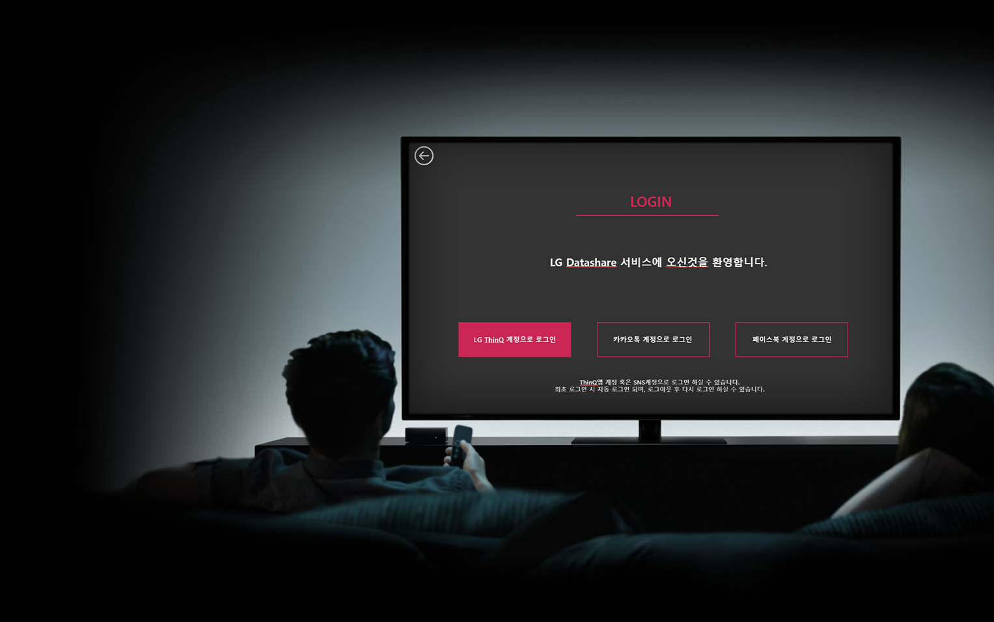
LGElectronic DataShare Service Development
Portfolio
LGElectronics
AWS IoT Core using TVinter-DataTransmission/implemented with Data Sharefeatures were implemented.
Infrastructure is based on IoT Core-based serverless architecture was implemented. (API Gateway,Lambda,DDB) Authentication structure is centered on AWS Cognito supporting SNSlogin. millions of TV Device were targeted, Currently PoC 1 phase was completed.
Service Provider ㈜TOSKY
Client LGElectronics
Period 2022.05~
Responsibilities
Development/Architecture Construction
Development Environment
AWS IoT Core,NodeJS,API Gateway,Lambda,DynamoDB,AWS Cognito

Slide 36
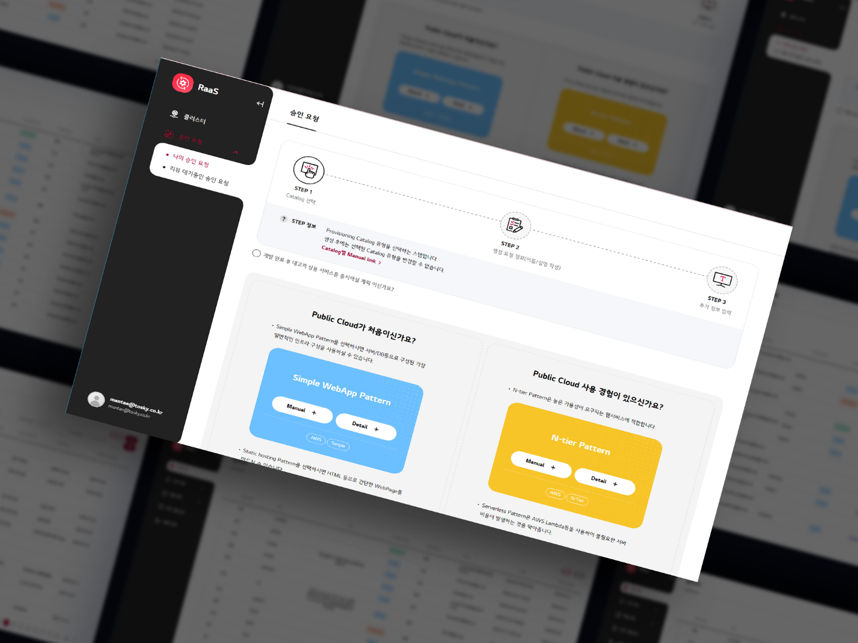
LG Electronic RaaS Project Construction/Maintenance
Portfolio
LGElectronics
LGElectronics internal developer staff's convenient Cloud environment configuration for one-click Cloud support system and IaC environment management system.
Configured for environments meeting the security standards of the largest domestic client IaC environment setup, CI/CD with administrator-friendly management web pages.
Service Provider ㈜TOSKY
Client LGElectronics
Period 2022.05~
Responsibilities
Development
Development Environment
AWS EC2, Lambda, Serverless, S3, API Gateway, Terraform, JPA, Keycloak

Slide 37
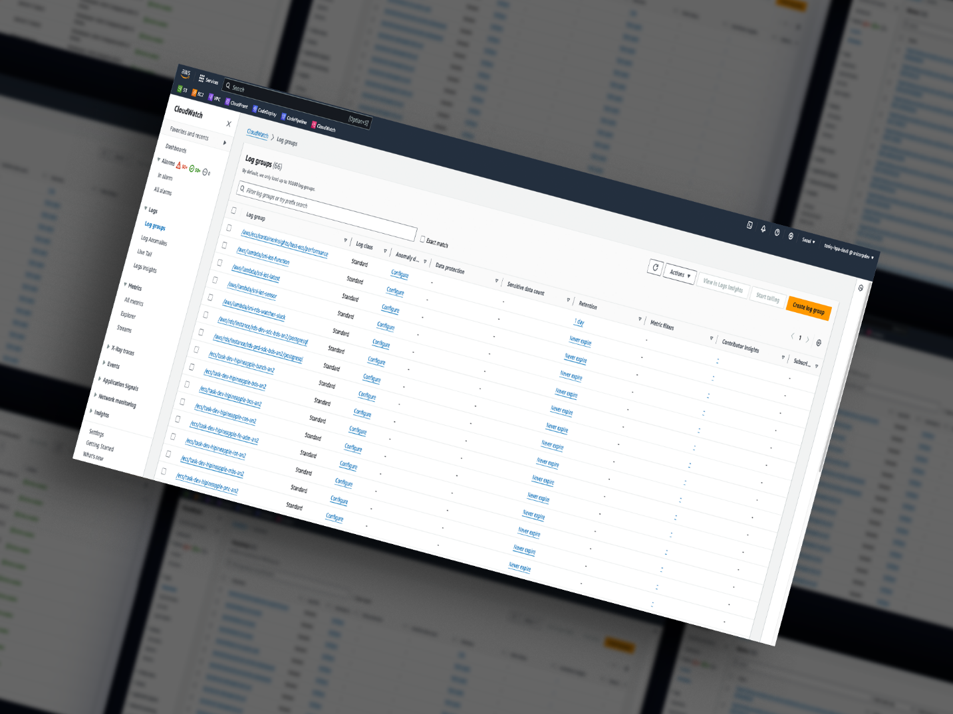
Ozys Data Lake Construction
Portfolio
Ozys
Scale Up/Downresponding dynamically to Nginxserver logs on Cloud integrated for centralized real-time monitoring with various alert services. CloudWatch using AccessLog for real-time monitoring and surveillance.
LogRotate for format-converted logs to AWS CLI through S3 loaded into Athena using S3 logs loaded in SQL for log analysis system search.
Service Provider ㈜TOSKY
Client Ozys
Period 2022.10 ~ 2023.01
Responsibilities
Development/Architecture Construction
Development Environment
AWS EC2, S3, CloudWatch, Athena

Slide 38
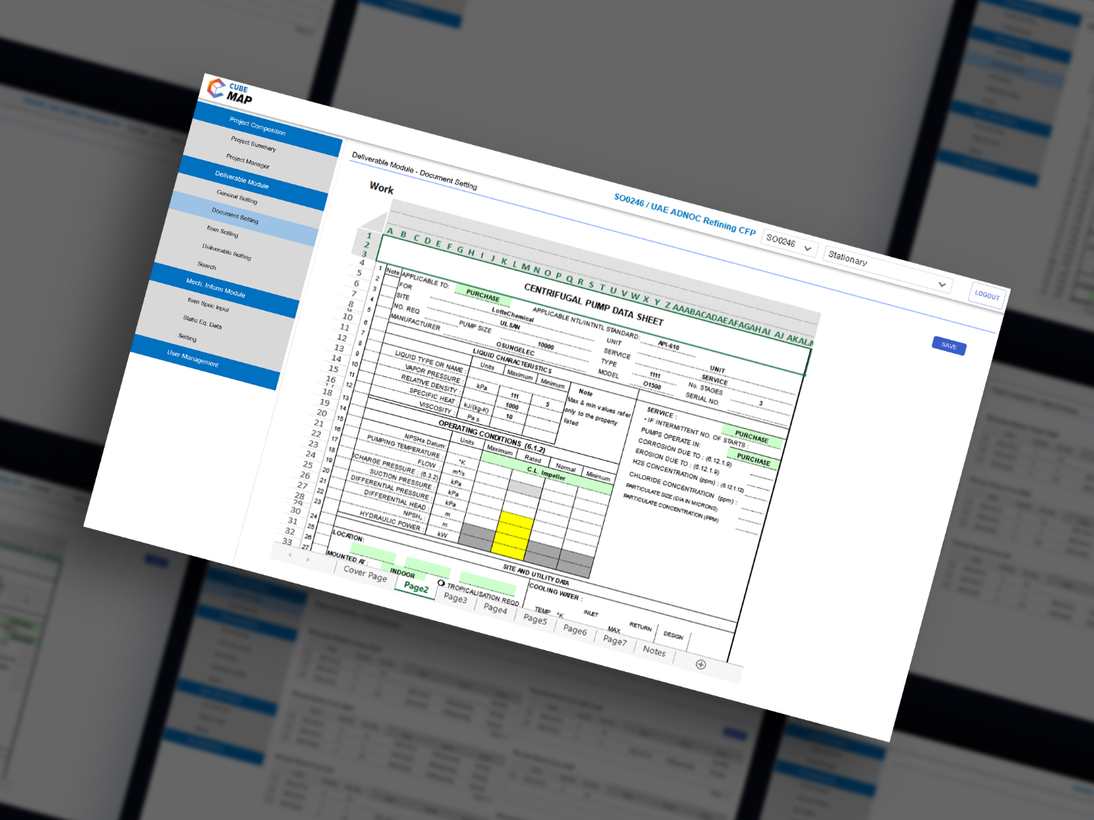
Samsung Engineering MAP Construction Project
Portfolio
Samsung Engineering
MAP(Maintenance Automation Platform) system provides project management and data integration Platform, user management, document settings, and item management as key features. Project and process information can be managed in detail, with various document template creation, Editing, and save functions supported. Maintaining latest information through inter-system data transfer and synchronization, with per-project item addition, deletion, and recovery functions included.
This Platformis designed for integrated data management and efficient project operations.
Service Provider ㈜TOSKY
Client Samsung Engineering
Period 2022.9 ~ 2023.03
Responsibilities
Development/Architecture Construction
Development Environment
AWS EC2, S3, MariaDB

Slide 39
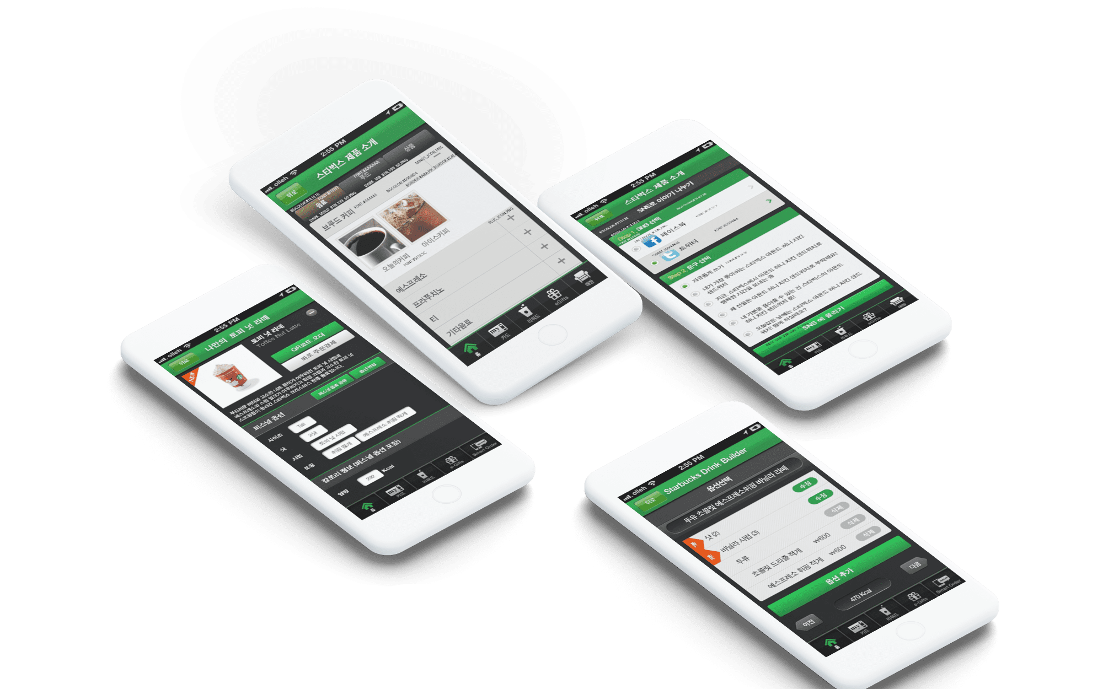
Starbucks Siren Order Application Development
Portfolio
Starbucks Korea
At a time when there were no mobile ordering systems in the F&B industry, this was the world's first Starbucks Siren Order system
This project involved 5related organizations(ShinsegaeINCetc.)and 20related departments(Marketing,POS,Planning,Innovation)involved in the project, approximately 30hundred million KRW scale project. The application development was managed as overall project lead. The system was developed domestically and reverse-exported to Starbucks US headquarters, currently accounting for approximately 70% of Starbucks revenue as a ordering system, which is the foundation for the recent proliferation of F&B ordering systems.
Service Provider ㈜Meeples
Client Starbucks Korea
Period 2013.02~2014.04
Responsibilities
Project Manager
Development Environment
Restful API Server(Spring), Android Application (Java),IOS Application(Objective C)

Slide 40
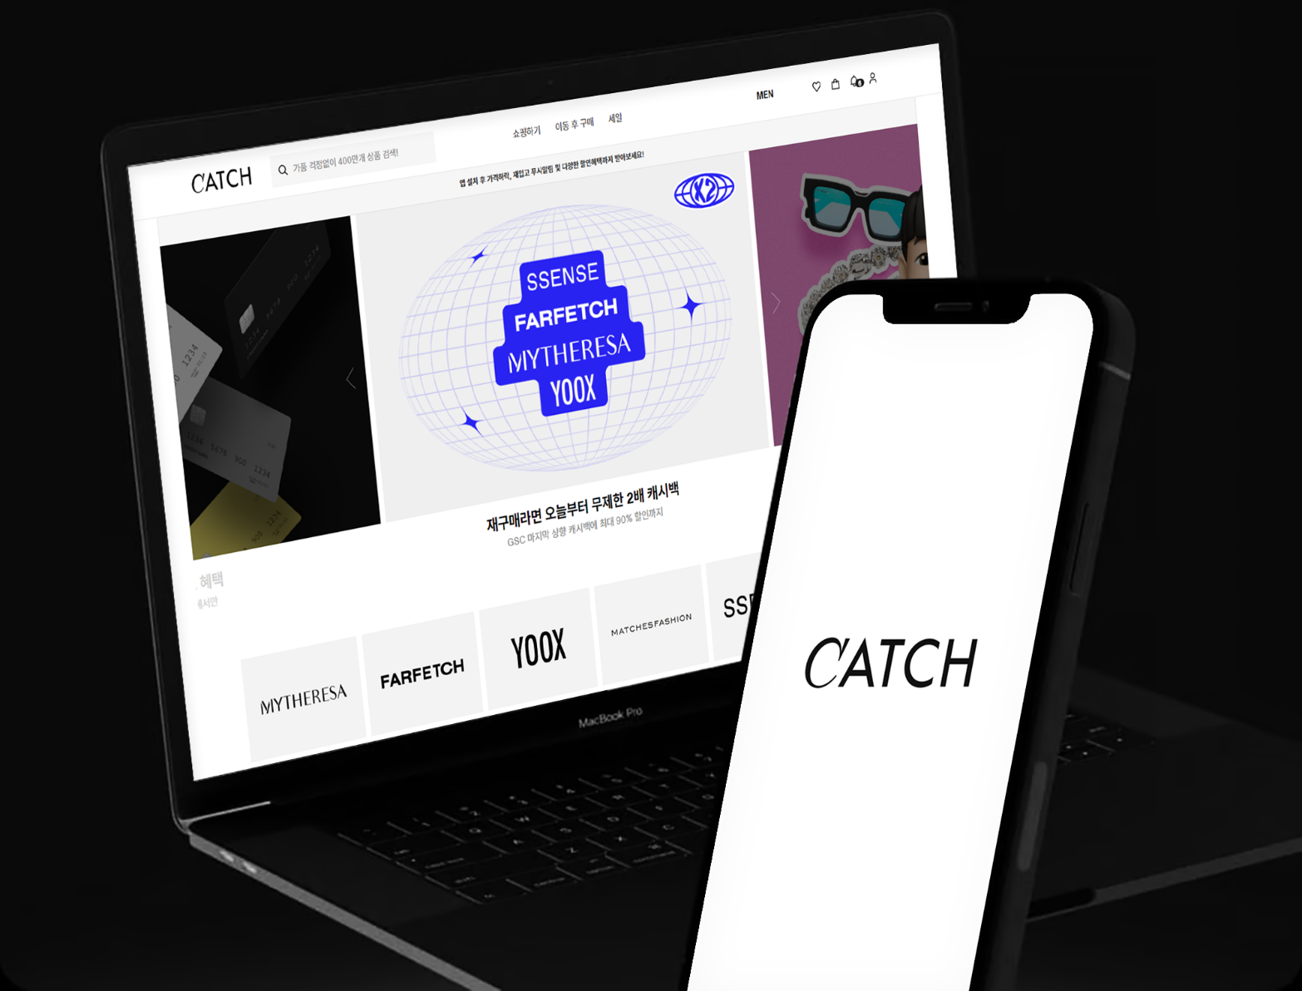
Catch Fashion Serverless System Maintenance
Portfolio
Catch Fashion
AWS Serverless Framework-implemented website and Crawling models were maintained and additionally developed.
Lambda, API Gateway, DDBand other Stack using Full Stack Serverless is implemented. AWS Infraalong with Serverless Framework, SQS, TypeScriptwere utilized.
Service Provider SC Comms㈜
Client Catch Fashion
Period 2022.04 ~ Currently
Responsibilities
Development/Architecture
Development Environment
AWS, Lambda, Serverless Framework, DynamoDB, API Gateway and other

Slide 41
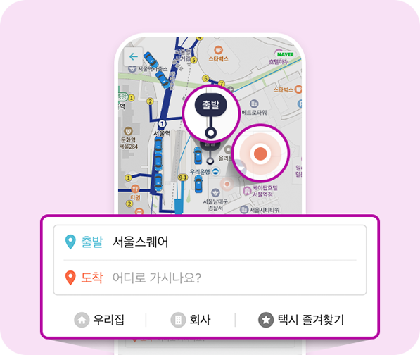
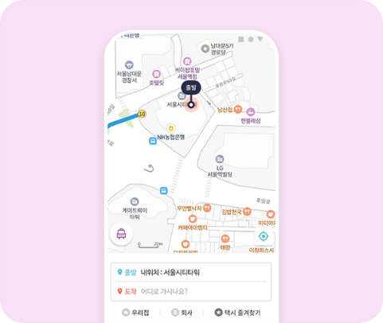

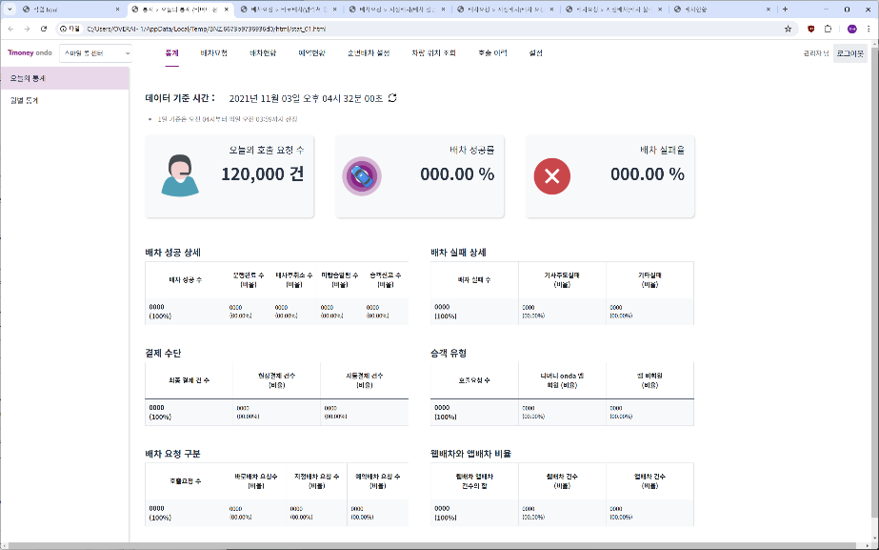
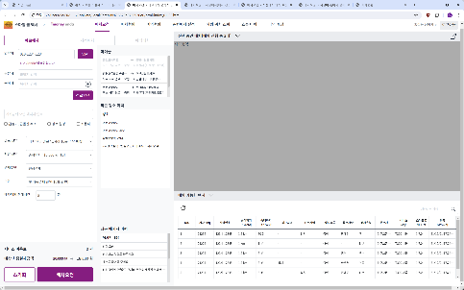

T-Money OndaCall Project Development
Portfolio
T-Money
T-Money OndaCall project consists of a taxi driver application and passenger application, and an administrator accessible control system.
TOSKY specifically performed ARS through incoming call taxi request intake calls are managed through administrators to intake, freely dispatch calls to taxi drivers for transport operations T-Money OndaCall project was executed.
Service Provider ㈜TOSKY
Client ㈜T-Money
Period 2019.07~2020.10
Responsibilities
Project Manager
Development Environment
Restful API Server(Spring), IOS Application (swift), IOPE Brand Web Legacy System Integration(spring)

Slide 42
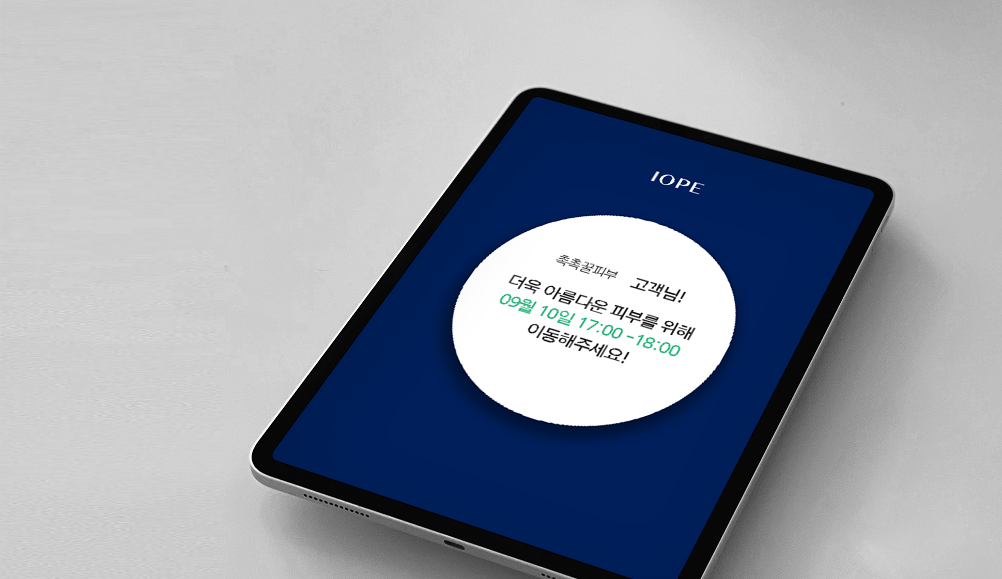
IOPE Skin Measurement On-Site Reservation Management System Development/operation
Portfolio
Amorepacific Inc.
IOPE Flagship Store(Research Institute)a reservation system for consumer skin analysis was developed.
Due to the project's nature of on-site reservations, , similar to a cinema reservation system, reservation/check-in/and check-out processes are structured, member/and non-member reservation processes,no show, refund processes are included.
Service Provider ㈜TOSKY
Client Amorepacific Inc.
Period 2019.07~2020.10
Responsibilities
Project Manager
Development Environment
Restful API Server(Spring), IOS Application (swift), IOPE Brand Web Legacy System Integration(spring)

Slide 43

IOPE Face Measurement-Based 3D MASK Project Development/operation
Portfolio
Amorepacific Inc.
IOPE Flagship Store(Research Institute)for consumer skin research and personalized mask packs providing differentiated services.
IOS Platformprovided by true-tone using the front camera to FACE ID APImeasure facial detailed dimensions(brow gap,nose width and length,eye length,lip length, etc.)measured with millimeter-level precision and segmented values then, measurement results are sent to 3Da printer to produce a mask sheet precisely fitting the user's face fittingand by area 6 types of serums are selected for area-specific benefits.
Service Provider ㈜TOSKY
Client Amorepacific Inc.
Period 2019.07~2020.10
Responsibilities
Project Manager
Development Environment
Restful API Server(Spring), IOS Application (swift), IOPE Brand Web Legacy System Integration(spring)

Slide 44

Seoul City Gas Marketing Situation Room Control Application Development
Portfolio
Seoul City Gas Group
A mobile situation room control application for Seoul City Gas Group managing western Seoul's city gas and billing.
Using Android tablets for regular tasks(leakage,meter reading, etc.)and civil affairs work(performance inspection,transfer, etc.)comprehensively performable, with functions to monitor each operator included. Notable features include, hundreds of thousands of marker efficiently displayed on the map,marker clustering server side directly implemented at the level, Bigdataand AIused in K-means clustering algorithm was used. Currently in Korea, on electronic maps markerserver sideat k-means using clustering there are no implementation cases, this is the first domestic implementation.
Service Provider ㈜TOSKY
Client Seoul City Gas Group
Period 2018.01~2018.04
Responsibilities
Project Manager
Development Environment
Restful API Server(Spring), Android Application (kotlin)

Slide 45

Haem e-tag Total Solution System
Portfolio
㈜Haem
mart/convenience store/replacing paper price tags used in marts, convenience stores, bookstores, etc. electronic ink price display device(software component) was developed.
The electronic tags come in various sizes and supported colors(black/white/blue)with designs and display components integrated with hardware system via TCP/IPbinarylocal server for display transmission, for displaying and managing product information on tags web console components. Up to 10,000or more electronic tags can be controlled at once , with per-tag 0.1second transmission time achieved.
Service Provider ㈜TOSKY
Client ㈜Haem
Period 2021.08~2022.02
Responsibilities
Overall Production Management
Development Environment
VB(with TCP/IP) Spring Boot(web console Component),Java 11,mariadb

Slide 46

Radiation Worker Comprehensive Information System
Portfolio
Korea Foundation of Nuclear Safety
A complete renewal project of the Radiation Worker Comprehensive Information System was performed.
The project includes institutional information/worker information/various radiation dose reporting functions permission-based reporting/confirmation/inspection processes and step-by-step verification processes are included. Additional features include reporting tools for record issuance database security module application, DApart design, etc..
Service Provider ㈜TOSKY
Client Korea Foundation of Nuclear Safety
Period 2020.12~2021.08
Responsibilities
Overall Development Management
Development Environment
e-Government Framework(egov 3.9), Java 11 (with spring)

Slide 47

Guide U (GuideU)
Portfolio
Period
2018
Responsibilities
GUI/application

Slide 48

Video Dating App “SimkungTalk”
Portfolio
㈜TOSKY
Dating app market demand increased, so an in-house service was prepared and launched.
webRTC -based libraries were compared and analyzed to select Remote Monster's library for service delivery with internal configuration leveraging SimkungTalk's technical specifications actively utilizing open source.
Service Provider ㈜TOSKY
Client ㈜TOSKY
Period 2021.01~2022.01
Responsibilities
Planning/Development/Deployment Component
Development Environment
Java,turn/stun/ice server ,sip

Slide 49

Cardio (CARDIO)
Portfolio
(Key)Cardio Health
Period
2022
Responsibilities
GUI/application

Slide 50

LGObject Collection (LG Objet Collection)
Portfolio
LGElectronics
Period
2021
Responsibilities
PC, Mobile web

Slide 51

Real Buy
Portfolio
Pipublic (PIPER BLEAK)
Period
2021
Responsibilities
PC, Mobile web

Slide 52

Kikiruki App (kikirookie)
Portfolio
Period
2018
Responsibilities
App GUI

Slide 53

CJ Viewing (CJ Viewing)
Portfolio
Period
2018
Responsibilities
App GUI

Slide 54

Caesar (CESAR)
Portfolio
Period
2019
Responsibilities
promotion GUI / GUI Guide

Slide 55

Sulwhasoo (Sulwhasoo)
Portfolio
Period
2019
Responsibilities
DID / SCREEN GUI / GUI Guide

Slide 56

iNature Natural Model Project
Portfolio
ENATURE

Slide 57

VSL Health Supplement Shopping Mall
Portfolio
VSL

Slide 58

BSCapital Mobile Branch
Portfolio
BSCapital
BSCapital mobile subscription system for product subscription, PDF form filling, billing document capture and other functions as a mobile electronic subscription application
Period
2013.05
Responsibilities
iPad Application

Slide 59

Choi Chang-ho's HEALING TIME
Portfolio
Sketch Lab
A mobile psychological test application by Dr. Choi Chang-ho and Sketch Lab
Period
2013.04
Responsibilities
Android app

Slide 60

KDB Moving Branch
Portfolio
KDB
KDB A mobile application for opening Daewoo Securities accounts, and making agreements via mobile Application
Period
2013.04
Responsibilities
Mobile Application

Slide 61

KERIS Education application
Portfolio
KERIS
A mobile application for digital textbook pilot project enabling curriculum study via smartphone Application
Period
2013.04
Responsibilities
Android app

Slide 62

KTH Smart Baseball broadcasting
Portfolio
KTH
2013 Professional baseball broadcast service OlleTVserviced via, Application within a hybrid application running on mobile web
Period
2013.07
Responsibilities
iPhone/iPad app

Slide 63

KT Olleh TV Now Smart Basketball broadcating
Portfolio
KT Olleh
2014 Professional basketball broadcast service OlleTVserviced via, Application a hybrid application running on mobile web within
Period
2013.07
Responsibilities
iPhone/iPad app

Slide 64

GICOMS Maritime Safety Comprehensive Information System
Portfolio
GICOMS
Ministry of Oceans and Fisheries GICOMS mobile migration project for vessels, and shipping companies can be searched, global weather and piracy information can be viewed via mobile
Period
2013.09
Responsibilities
Android app

Slide 65

MINI MONEY Mini Money
Portfolio
GICOMS
Money-earning Application Mini Money. An app that earns points by watching ads Reward Service .
Period
2013.09

Slide 66

MUV Danal
Portfolio
MUV
Danal Entertainment Muv Music App Purchase music, and apply for parties and concerts. The AppGroup chat and individual chat features similar to KakaoTalk messenger were developed
Period
2013.12

Slide 67

CERGEM Cellupedic
Portfolio
CERGEM
Korea's leading medical device company Ceragem's medical devices controlled via mobile as a remote control replacement Application
Period
2014.01
Responsibilities
Android app

Slide 68

Live Homeshopping Live Home Shopping
Portfolio
Sketch Lab
Mobile Shopping, Keeping pace with rapid growth, home shopping 6companies partnered to Live Homeshopping Appprovide broadcast services via
Period
2013.12
Responsibilities
Android app

Slide 69

Samwontech SIMS
Portfolio
Digital recording equipment and SIMS Application communication with Wifi for equipment monitoring Application
Period
2014.01
Responsibilities
Android app

Slide 70

KOVA TIME SALE
Portfolio
KOVA
Shopping information you didn't know about... now at a glance

Slide 71

Korea Institute for Industrial Economics and Trade ISTANS Industrial Statistics
Portfolio
Korea Institute for Industrial Economics and Trade
ISTANS Industrial statistics data served via mobile web and app
Responsibilities
iPhone App & Contents

Slide 72

SMART LOG
Portfolio
Korea Institute for Industrial Economics and Trade
Responsibilities
Android App

Slide 73

Samsung Wallet Send/Receive Service
Portfolio
(Key)YellowPay
Responsibilities
Android App

Slide 74

King's Interview English ,and Korean interview application
Portfolio
(Key)YellowPay
King's Interview Sketch Lab jointly developed
mobile interview application
Responsibilities
iPhone App & Contents

Slide 75

Muju-gun Culture & Tourism SNS Development
Portfolio
(Key)YellowPay
Muju-gun cultural tourism site introduction and location, event and festival information provided SNS
Responsibilities
iPhone App & Contents

Slide 76

SamsungLED Smart Grid
Portfolio
SamsungLED
Responsibilities
iPhone App & Contents

Slide 77

Gmarket G magazine
Portfolio
Gmarket
GMarket product and lifestyle information introduction
Responsibilities
Smart Phone UI & Contents

Slide 78

Woongjin Coway Sales Tool
Portfolio
Woongjin Coway
Responsibilities
Smart Phone UI & Contents

Slide 79

beesket POS system
Portfolio
beesket
BEESKET POS SystemWeb administrator and client Systemdevelopment project
Period
2013.09
Responsibilities
POS System

Slide 80

DIOWISETELL Repot module
Portfolio
DIOTECH
ARS -based voice recognition service server monitoring and management Flex Application
Period
2013.09
Responsibilities
Android app

Slide 81

LTAS Report Module
Portfolio
olleh
KTA tool for reporting mobile data usage of manufacturer statistics, regional statistics, LTE Traffic for at-a-glance status monitoring Application
Period
2013.08
Responsibilities
Web

Slide 82

MyplTalk myplacetalk API
Portfolio
MyplTalk
nationwide restaurant, accommodation, etc. 92ten thousand data API information site for API product application, management and statistics
Period
2013.09
Responsibilities
Web

Slide 83

SK Tellink SEVION
Portfolio
SK
A fault monitoring system applied to the telecommunications field with real-time fault detection/monitoring/traffic/control and permission management for at-a-glance system and fault status visibility.

Slide 84

Hanssem Mobile Shopping Mall
Portfolio
Hanssem

Slide 85

Cloud Consulting Winkle Application Development
Portfolio
1. Location-Based Service(LBS) 2. Automatic friend addition from phone contacts 3. Detailed merchant information 4. Visited business check-in -> Discount coupon issuance 5. Single play check-in alone 6. Group play check-in with friends
Responsibilities
IOS, Android App Development

Slide 86

Mobile Restaurant AdvertisingPlatform Coupdata
Portfolio
Restaurant Social Marketing Platform Features : Coupon Creation, LBS -based, Store Creation, Favorite Store/Wishlist Feature, Coupon Review/Store Review and Sharing, advertisingCPI advertisingBM
Responsibilities
IOS, Android App Development

Slide 87

Woori Investment Securities Mobile Account Opening
Portfolio
Woori Investment Securities
Woori Investment Securities mobile electronic subscription service
Responsibilities
IOS, Android App Design

Slide 88

WA Player
Portfolio
(Key)OEG Soft
Listen to music on smartphone, E·Qfind optimal sound through testing and configure the equalizer Music Play, List organized by artist and album, E·QMeasurement E·QSettings
Responsibilities
IOS, Android App Development

Slide 89

INGLife Mobile Web Development
Portfolio
INGLife
INGLife website Mobile Webbuilt for service delivery via
Responsibilities
iPhone App & Contents

Slide 90

INGLife Mobile Web Development(Tablet)
Portfolio
INGLife
Responsibilities
Mobile Web Development

Slide 91

U+ Box Webhard Integration
Portfolio
LG U+
On smartphone, U+Boxcheck files stored in and upload captured photos/and videos to store them and enjoy various genres of free VOD content(Maintenance) Music Play, Video Viewing, VOD Viewing, File Upload, My File Storage
Responsibilities
IOS, Android App Development

Slide 92

mBookViewer Android E-Book Viewer
Portfolio
LG C&S, Sungdo SoluOne
Android tablet-based e-book viewer App Book Download, Video playback included in book, Book(Zoom In/Out)
Responsibilities
IOS, Android App Development

Slide 93

BookPal Ebook Viewer
Portfolio
Book Pal
E-book viewer for iPhone and Android phones App Book Download, Content playback included in book
Responsibilities
IOS, Android App Development

Slide 94

Smart Leaflet Social Marketing App
Portfolio
(Key)Answer
Real-Time Mobile Flyer Flyer Promotion, Advertising Support, Social Marketing, Event, Shopping Support
Responsibilities
IOS, Android App Development

Slide 95

MAMIS Accident Response
Portfolio
Korea Coast Guard
MAMIS Accident Response Application Development Material Information, Providing functions such as containment methods
Responsibilities
IOS, Android App Development

Slide 96

Saramin GeogieOddae
Portfolio
Saramin
Responsibilities
iOS App Development

Slide 97

Tongyang Life Mobile Account Opening
Portfolio
Tongyang Life
Tongyang Life mobile electronic subscription service
Responsibilities
Android App Development

Slide 98

CJ DDanDDeok Application Development
Portfolio
CJ
An app for taking photos and participating in events
Responsibilities
IOS, Android App Development

Slide 99

Hi Juliet
Portfolio
Social Dating Service Hi Juliet 1:1 Matching System Introduction In APP Payment
Responsibilities
IOS, Android App Development

Slide 100

CJ Hello vision Tving
Portfolio
CJ
Tving web version Flash Application Development, Broadcasting VOD Service, DRM Function, P2P Function Support
Responsibilities
Flash web version UI & Contents

Slide 101

Yonhap News Touchscreen Work
Portfolio
Yonhap News
Content needed for Yonhap News broadcast displayed on large touchscreen for anchors to present the news
Responsibilities
Adobe air Contents

Slide 102

Samsung Theme Story Development
Portfolio
Samsung Electronics
Samsung Electronics Camcorder division's bundled application UI for C++ Diicommunication-based photo editing application
Responsibilities
FLEX UI & Contents

Slide 103

SAMSUNG SDS Talent Management System
Portfolio
SAMSUNG
Talent DB Integration Graph View Multi-face Popup Feature
Responsibilities
FLEX UI & Contents

Slide 104

SAMSUNG Electronic Theme stroy Development
Portfolio
SAMSUNG
Samsung Camcorder Division Bundled Software Speech Bubble Feature Theme Story Editing Feature Story Telling Video Output
Responsibilities
FLEX UI & Contents

Slide 105

SKNetworks Monitoring system
Portfolio
SKNetworks
Communication with Network Equipment, When Failures Occur, Noti Load Check by Carrier
Responsibilities
FLEX UI & Contents

Slide 106

Uangel Communication Fee Product Design
Portfolio
Uangel
Communication Plan Design Feature Tree View Provided Table View Provided
Responsibilities
Adobe Air UI & Contents

Slide 107

LG Electronic U-Healthcare Development
Portfolio
LG Electronics
Blood Sugar Measurement BMI Measurement ECG Measurement Blood Oxygen Saturation Measurement
Responsibilities
Adobe AIR UI & Contents

Slide 108

LGElectronic Smart TVfor SmartGrid
Portfolio
LG Electronics
Responsibilities
iPhone App & Contents

Slide 109

ArirangTV news viewer
Portfolio
ArirangTV
System development for digital broadcasting of morning newspapers
Responsibilities
Smart Phone UI & Contents

Slide 110

GICOMS Web Sites Development
Portfolio
Ministry of Oceans and Fisheries

Slide 111

CGPCS Web Sites Development
Portfolio
Ministry of Foreign Affairs

Slide 112

MSC Web Site Development
Portfolio
MSC

Slide 113

KBS Event Page Development
Portfolio
KBS

Slide 114

Olleh Bike Site Development
Portfolio
olleh

Slide 115

olleh tv smart
Portfolio
olleh

Slide 116

CIRCLE PUSH
Portfolio

Slide 117

General Assembly Pension Foundation Website
Portfolio
General Assembly Pension Foundation

Slide 118

Live Home Shopping Website
Portfolio

Slide 119

Vessel Port Entry/Exit Management Comprehensive Information System Construction
Portfolio
Korea Coast Guard
Responsibilities
Web Sites Development

Slide 120

Server Monitoring System (Sevion)
Portfolio

Slide 121

Event Management System (CMS)
Portfolio

Slide 122

MSC Brain Type Test Management System (CMS)
Portfolio
MSC

Slide 123

TimeSale Management System (CMS)
Portfolio

Slide 124

Hospital Medical Card Push Message Management System
Portfolio

Slide 125

QR Code Design
Portfolio

Slide 126

Kids Warner Flash Game
Portfolio
WARNER BROS.
Responsibilities View More
Kids Warner Game Production and UI Work

Slide 127
Thank You
TOSKY

